Slide 1



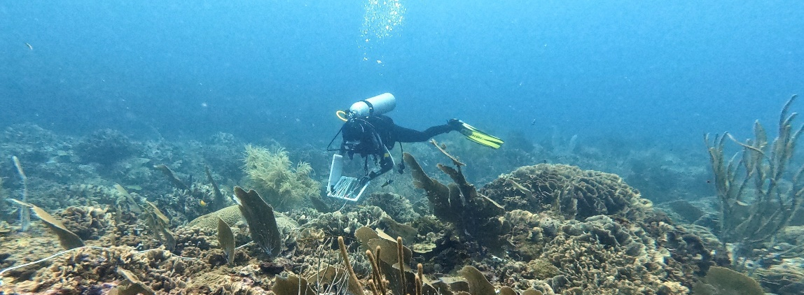


3rd Clean Pacific Roundtable Side Event # 5 November 17 2021
Presented by Mr. Christopher Corbin, Christopher.Corbin@un.org

Slide 2
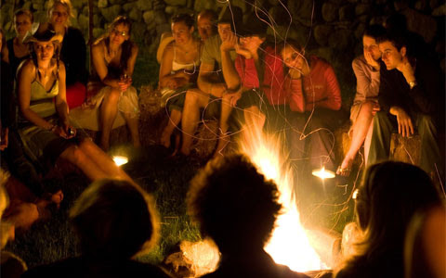
Tim Tim “Bois Sec” Tim Tim “Bois Sec” Our Talanoa
The Chronicle November 9, 2018

Slide 3
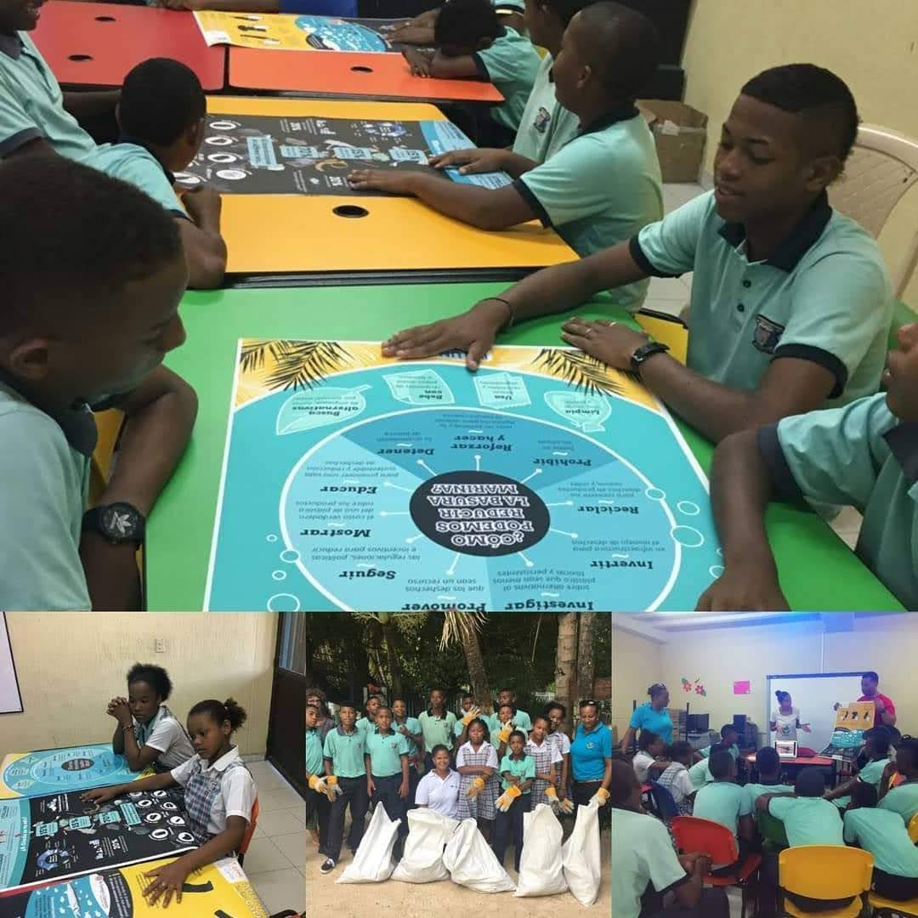

BEST PRACTICE
How we communicate!

Slide 4
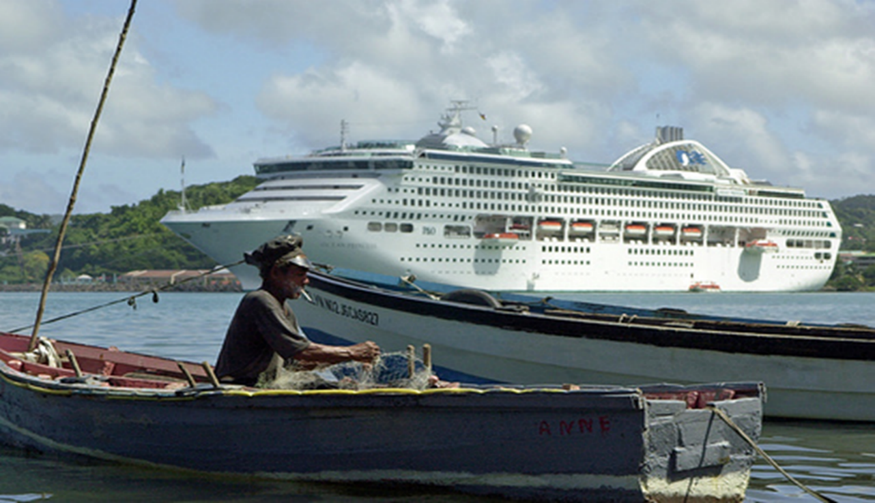
Let’s Take a Journey through the Caribbean & tell a Story
Notes:
Part 1 -title

Slide 5
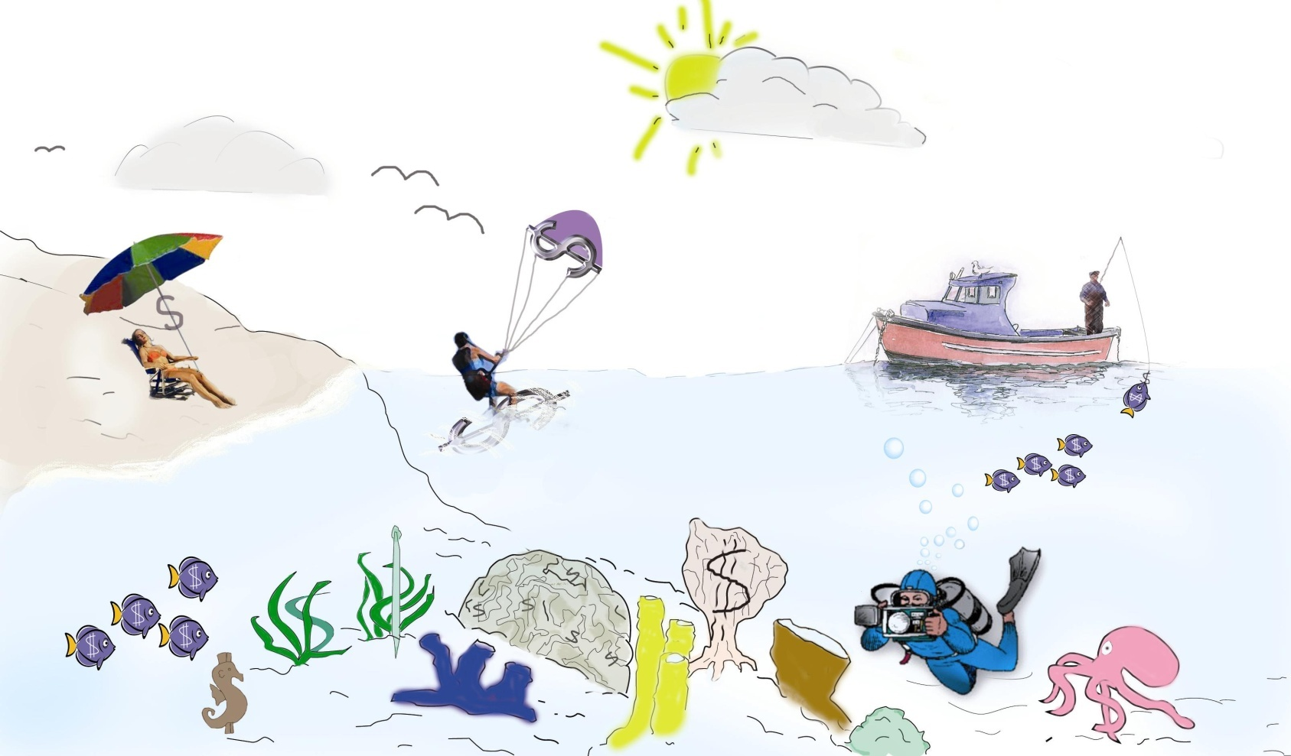

Why do we need to address pollution from waste?
Caribbean SIDS economies are the most tourism-dependent. Tourism is the largest economic activity, accounting for an average of 45 percent of the region’s GDP.
1% of global ocean space
40 SIDS & territories 40 million people
20% of globally significant marine biodiversity 8-35% endemic

Slide 6
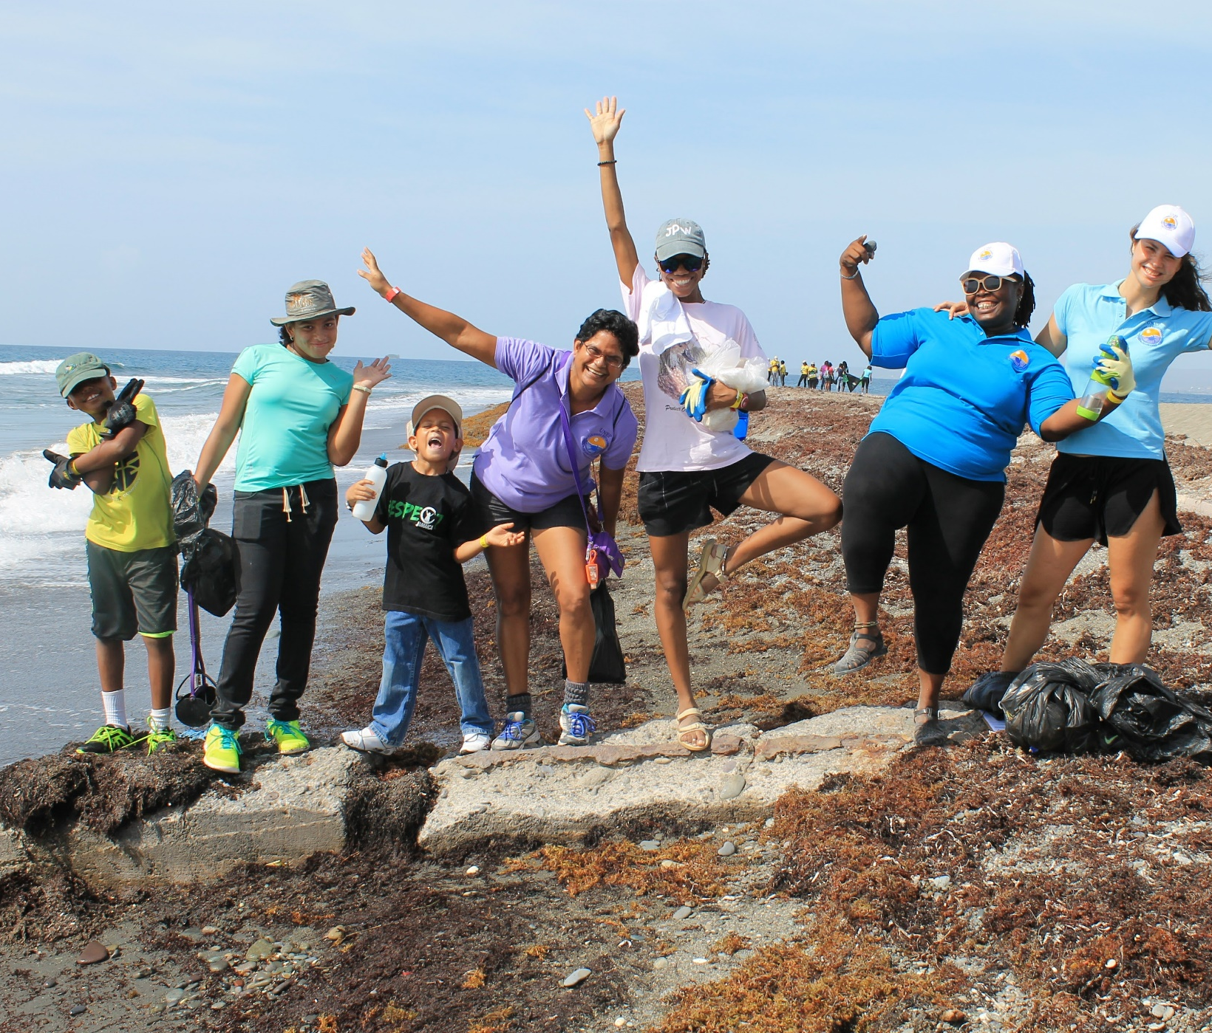
BEST PRACTICE
Embrace our History & Culture!

Slide 7
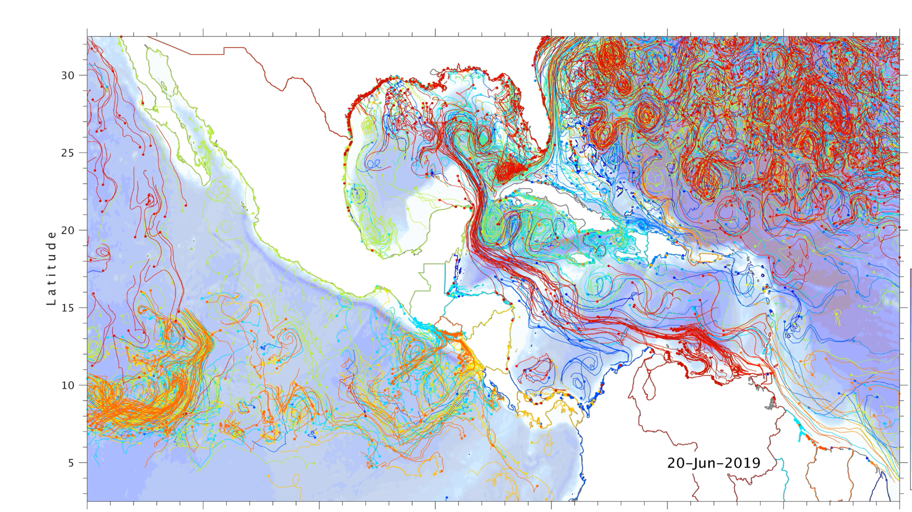

Slide 8
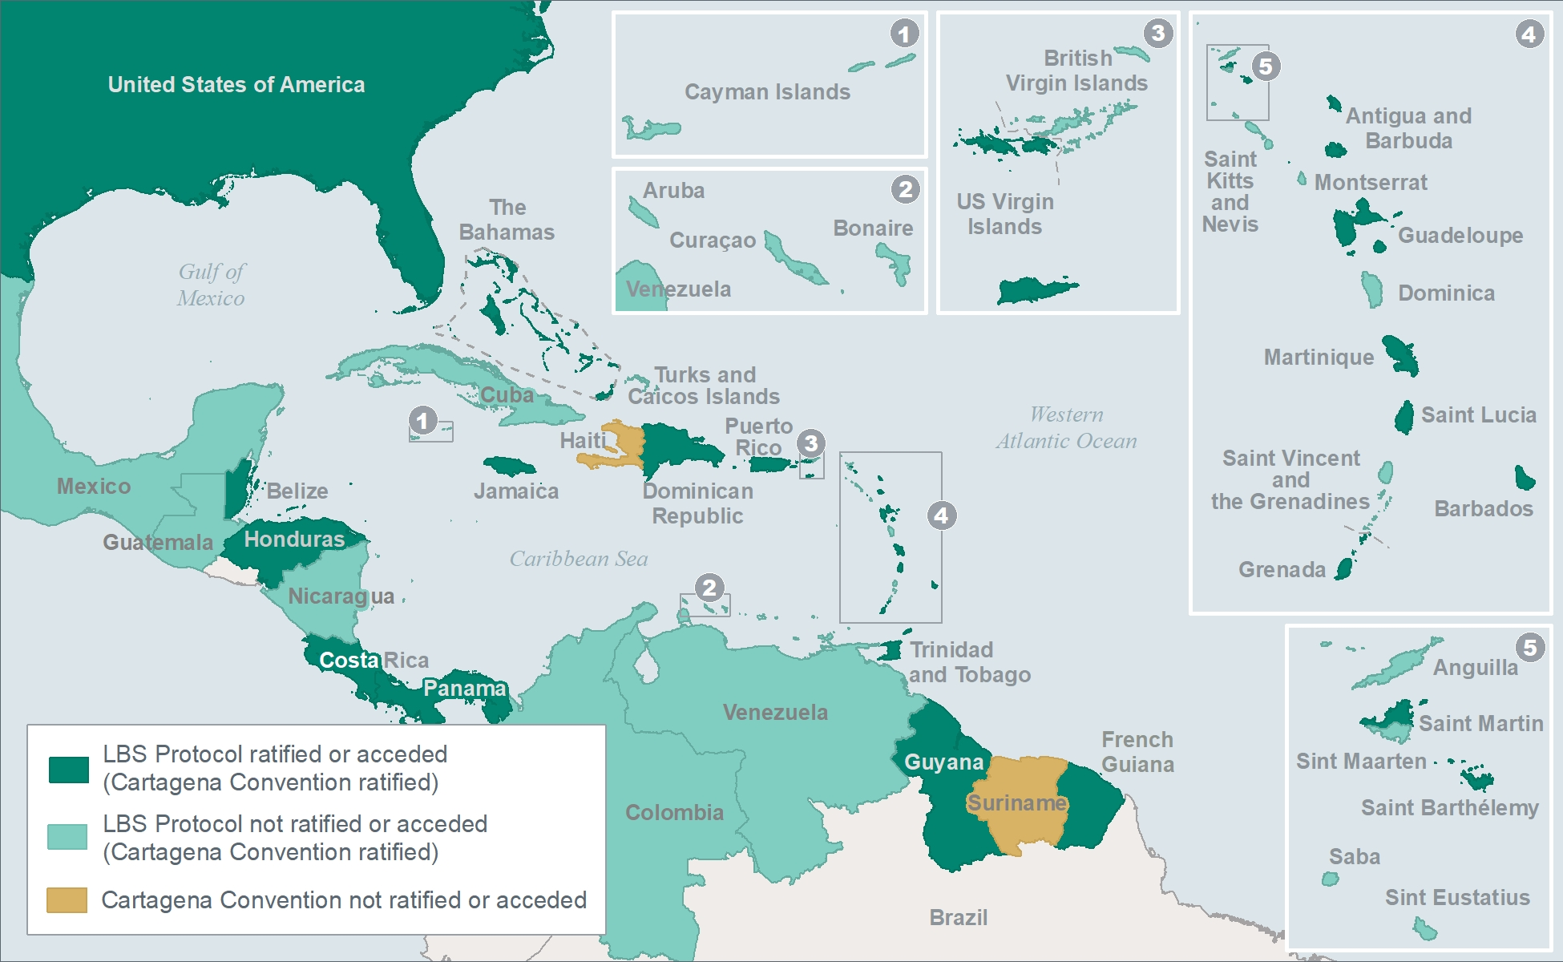

Slide 9
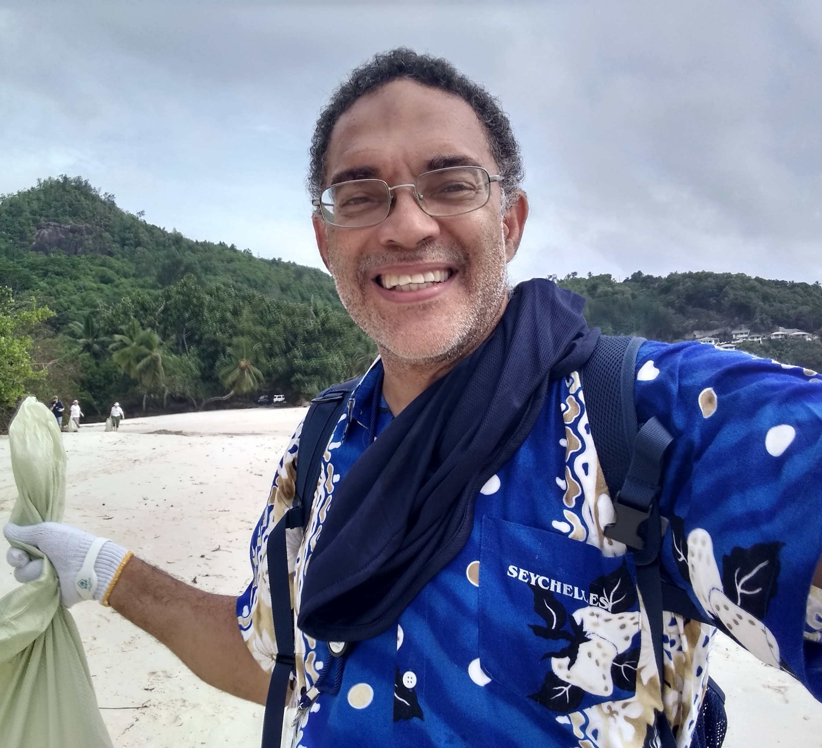
BEST PRACTICE
Everything is connected!

Slide 10
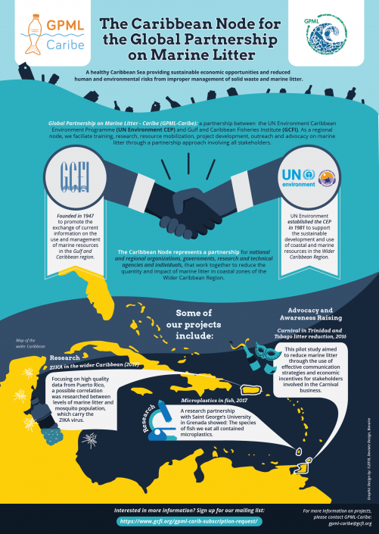
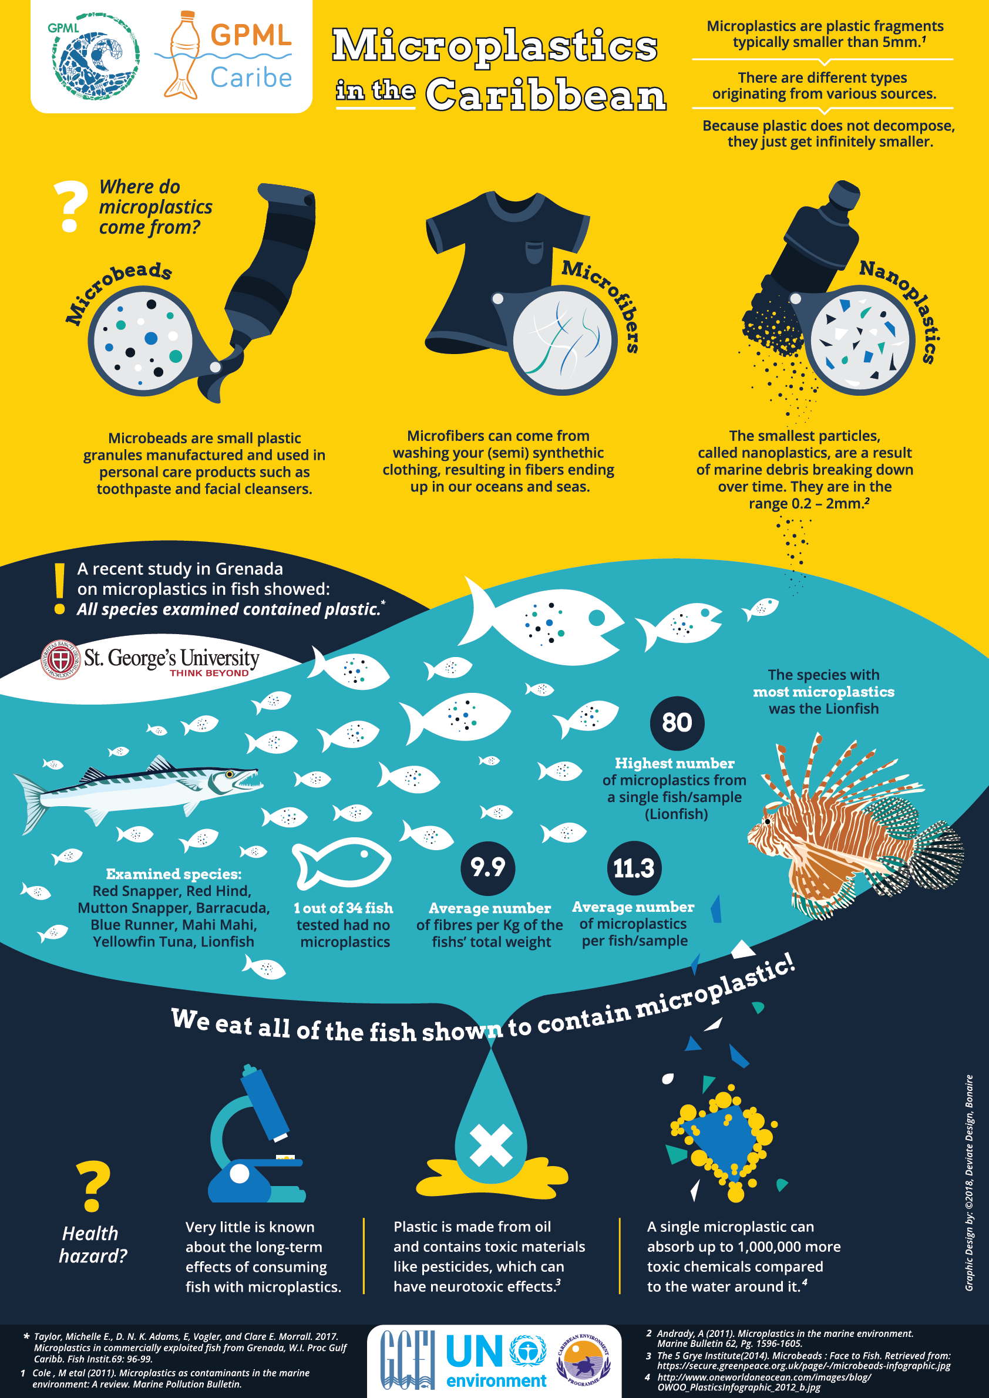

Slide 11
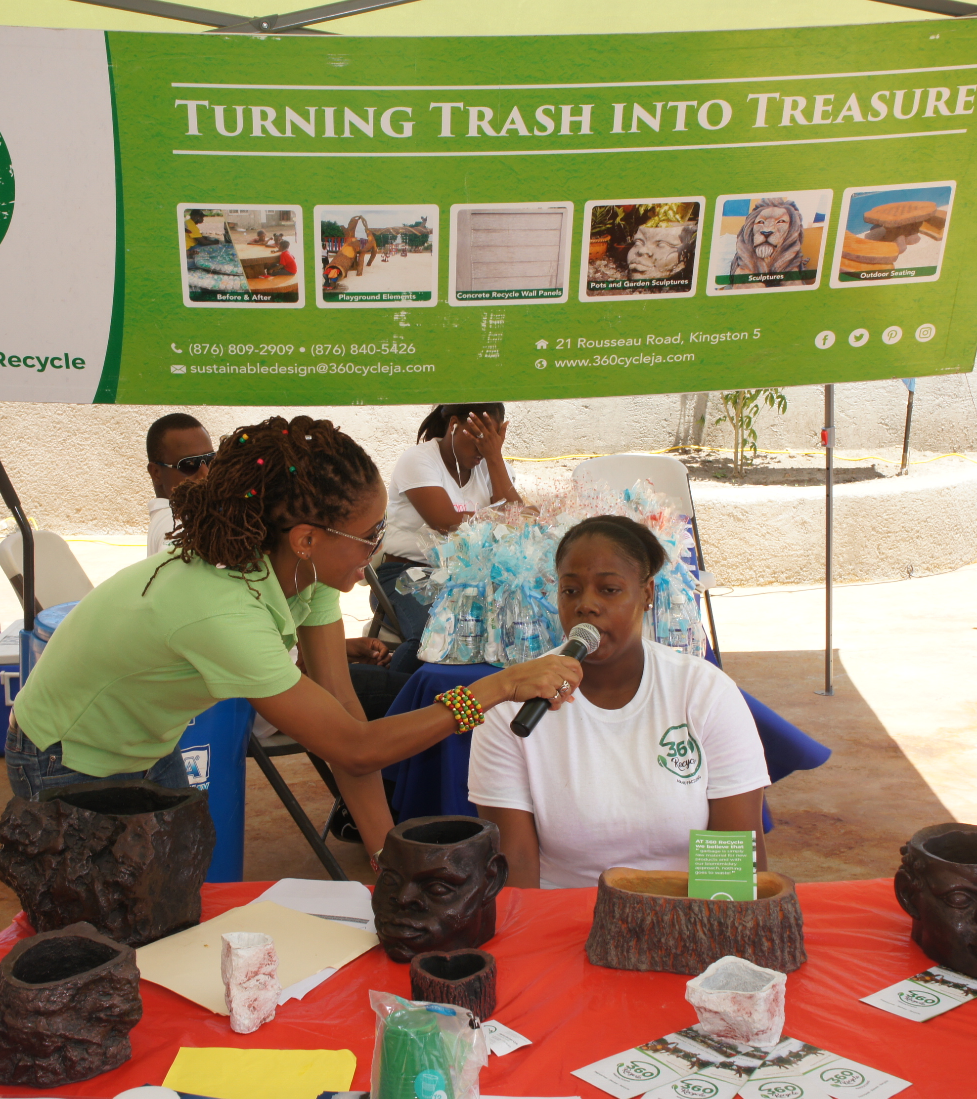
BEST PRACTICE
Partnerships are key to success!

Slide 12
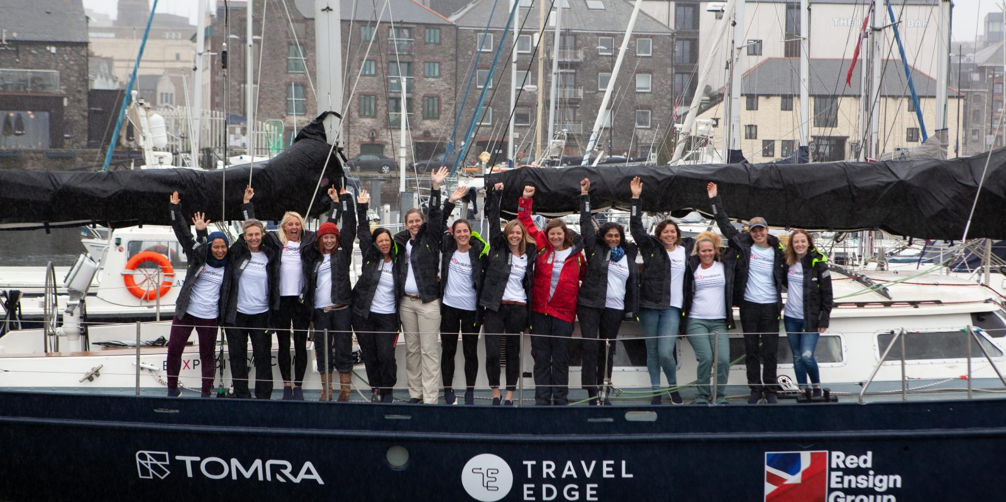
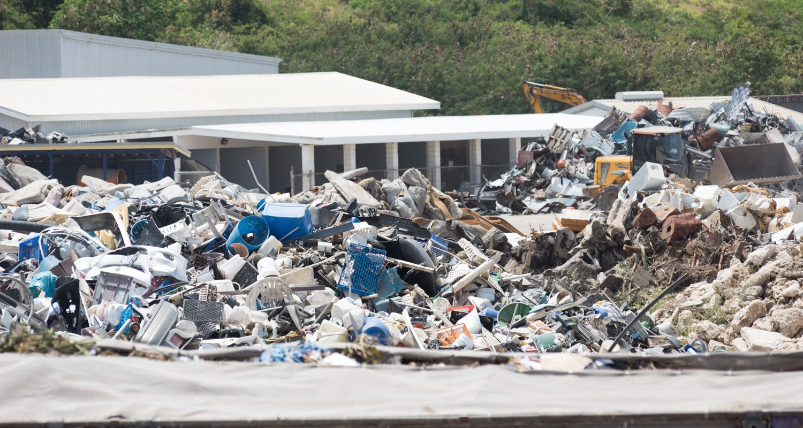
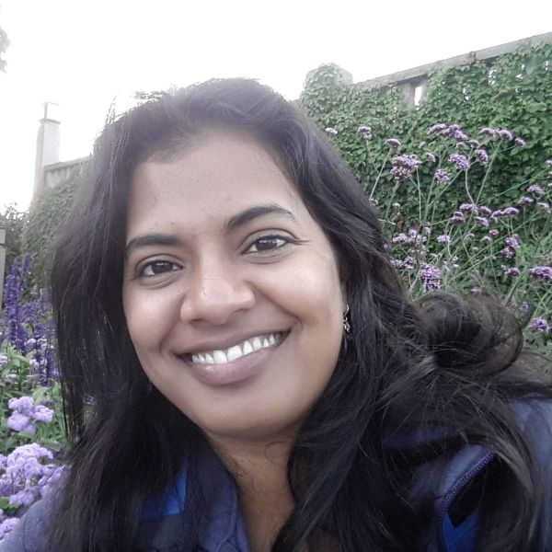
eXXpedition: All-female voyages exploring ocean plastic pollution, helping people use their skills to solve it.

Slide 13
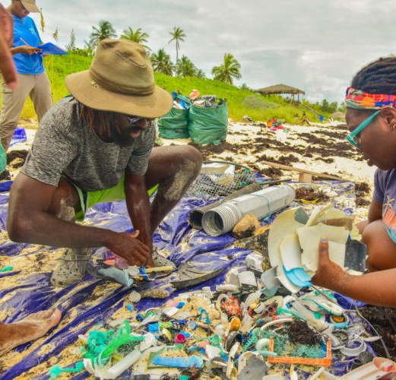
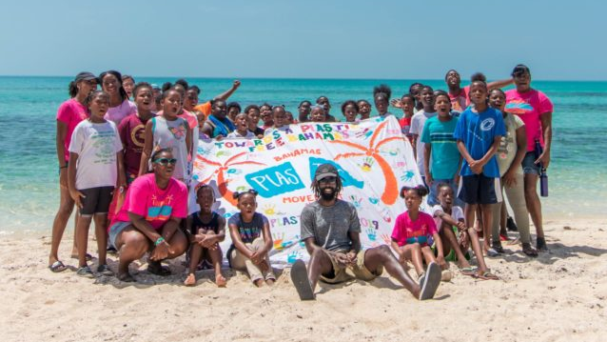

Slide 14
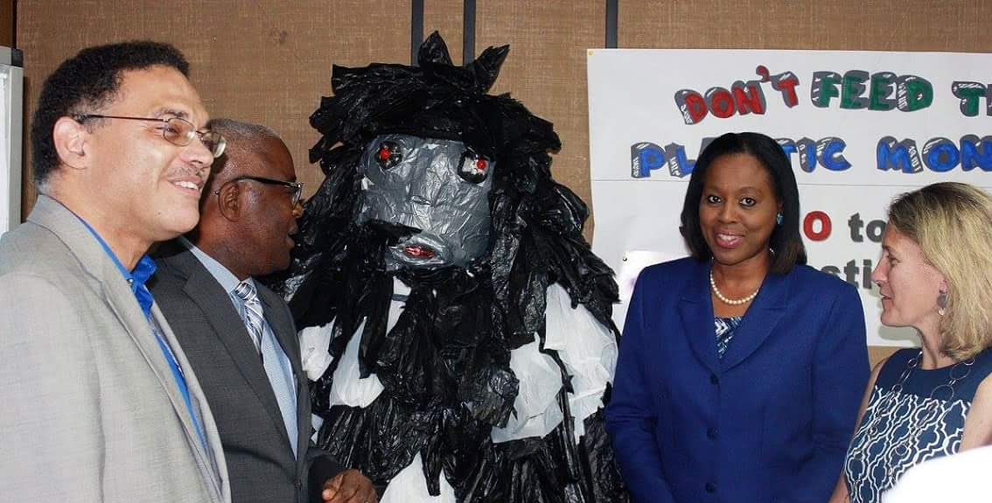
LESSON LEARNT
We all need to be champions!

Slide 15
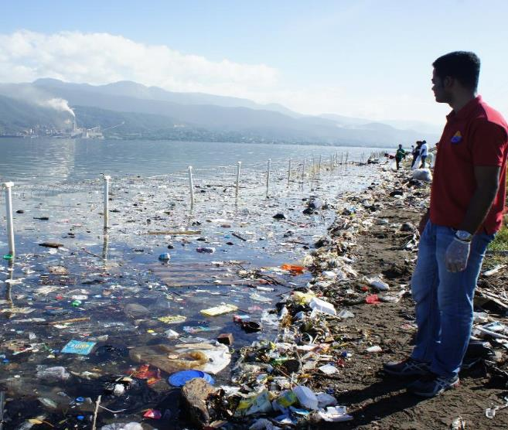
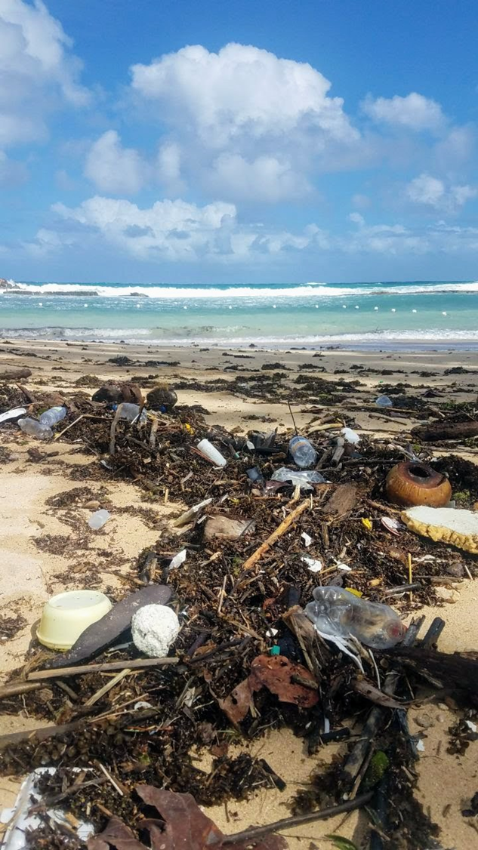
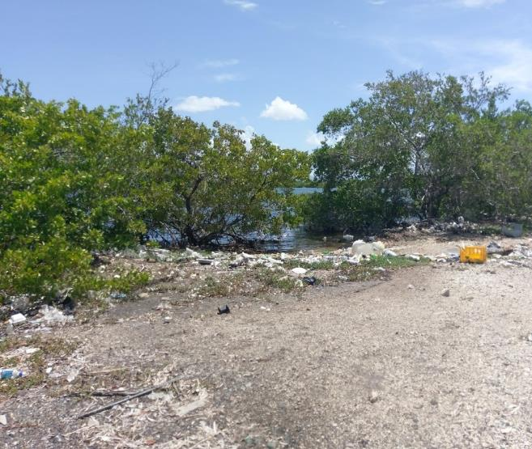
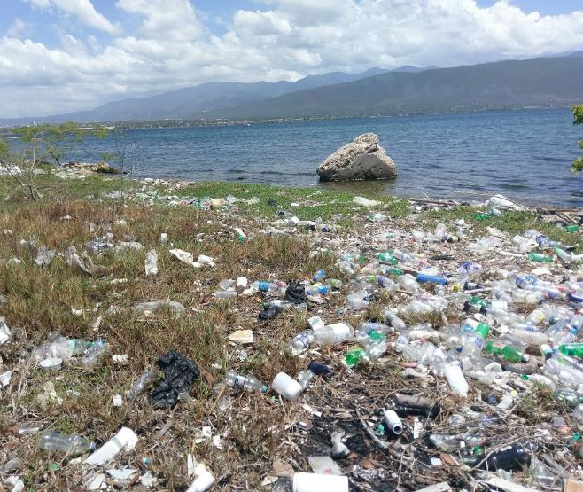
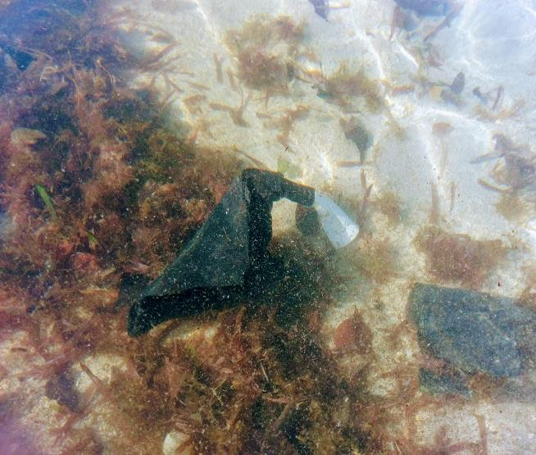
Where do I begin?
Caribbean Countries are the biggest plastic polluter per capita in the world
The Caribbean Sea has one of the highest concentrations of floating plastic (2nd to Mediterranean Sea)

Slide 16
LESSON LEARNT
It is a big problem but “one one coco full basket” – Do not expect to achieve success overnight!

Slide 17
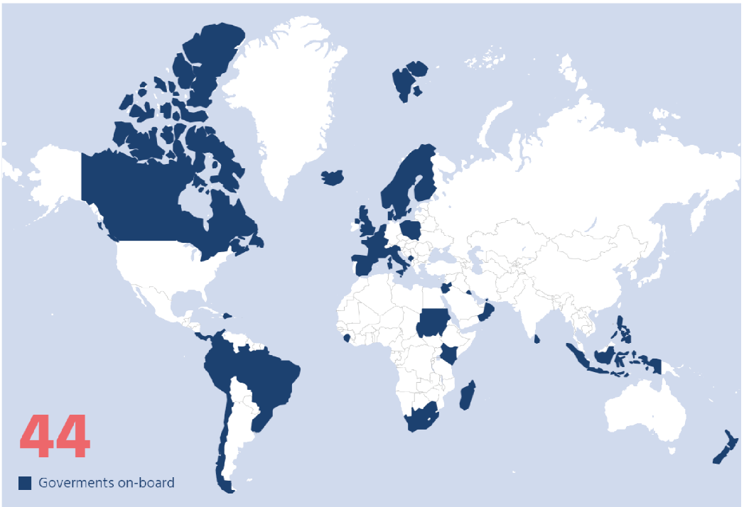
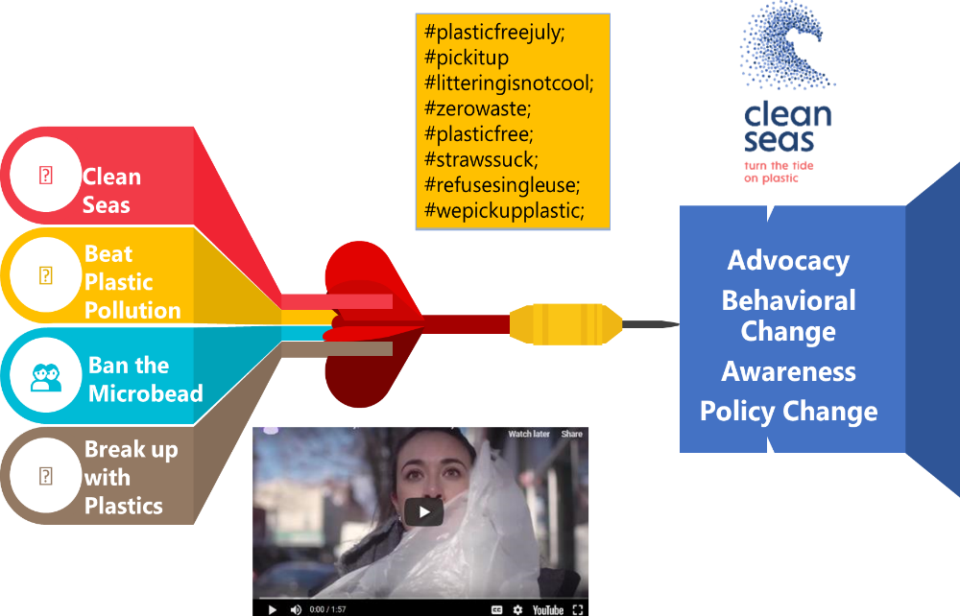

Partnerships for Education, Awareness & Advocacy
In Latin America & Caribbean
> 20 countries
Source: http://www.cleanseas.org/
>60

Slide 18
BEST PRACTICE
Find the right entry points,
Be opportunistic & Sustain Awareness

Slide 19
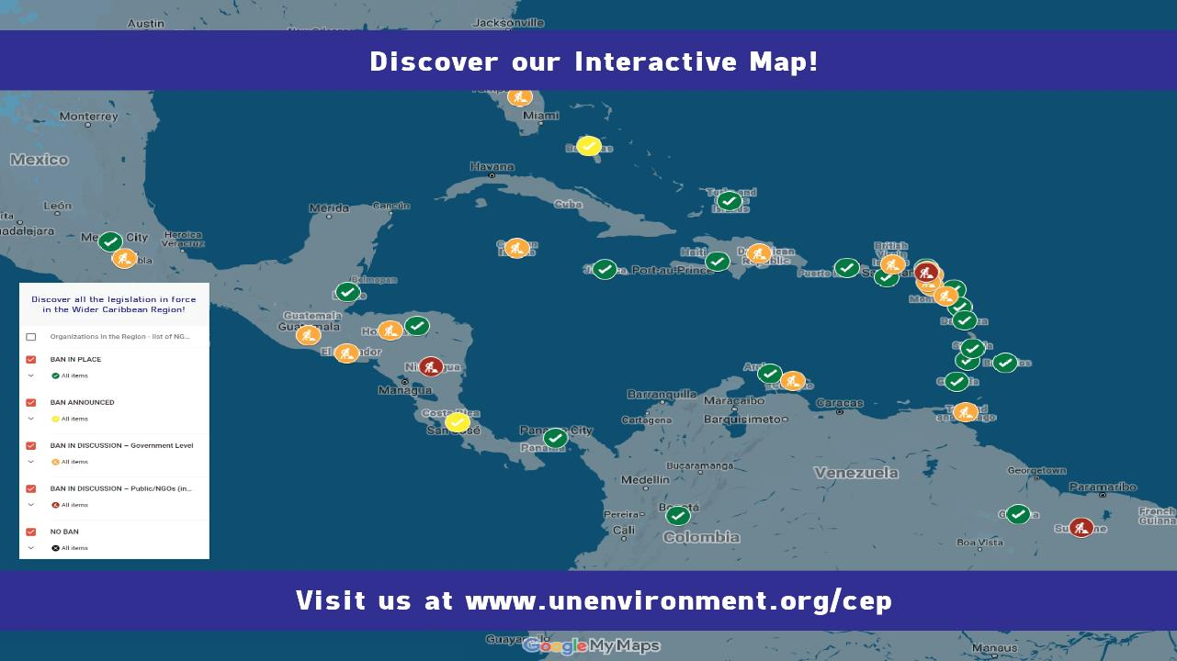
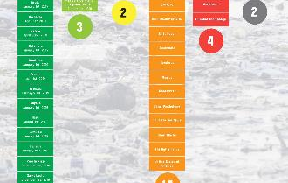

Slide 20
LESSON LEARNT
Be Brave -Sometimes you need a leap of faith

Slide 21
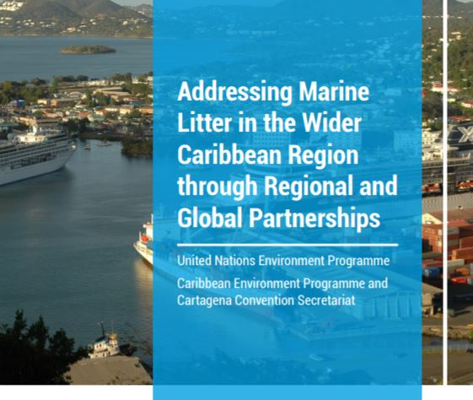
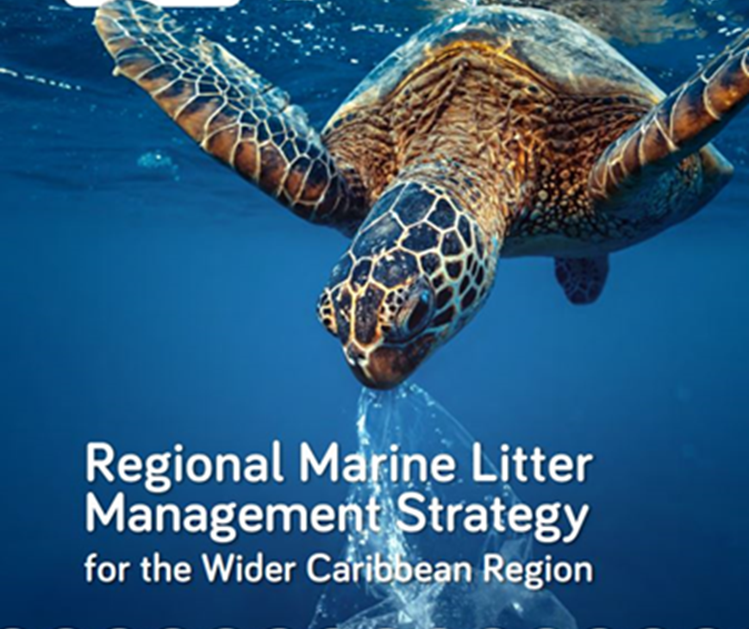
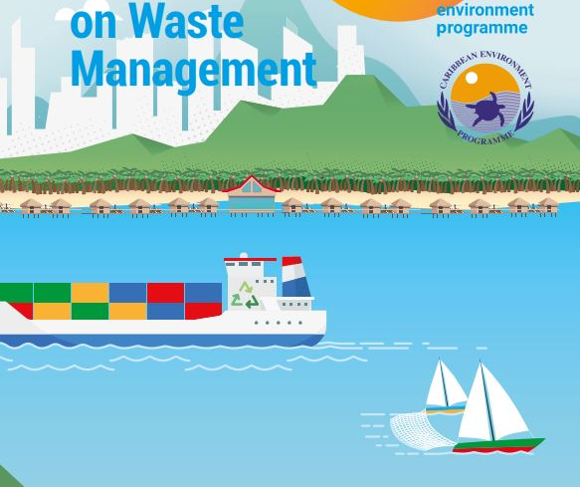
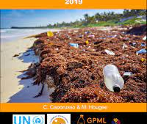
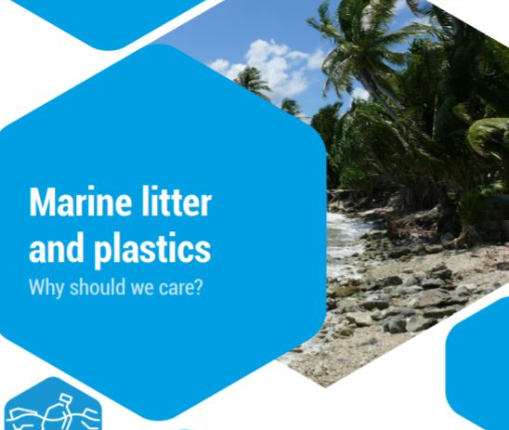
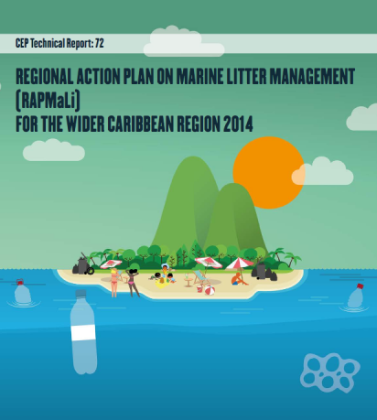
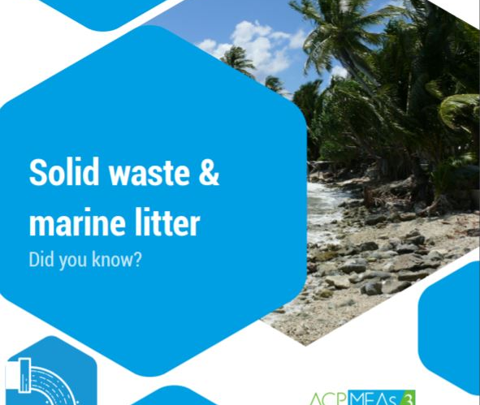

Slide 22
LESSON LEARNT
We can influence the Regional & Global Policy Agenda if we are at the table!

Slide 23
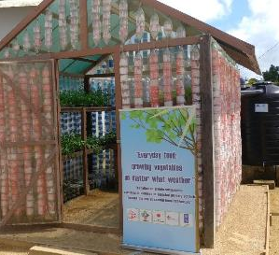
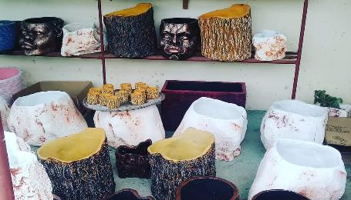
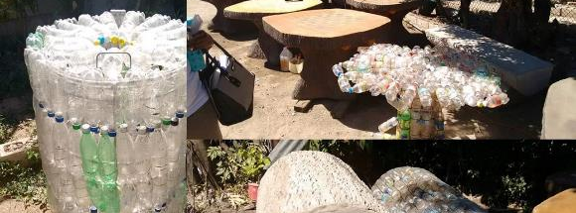

Slide 24
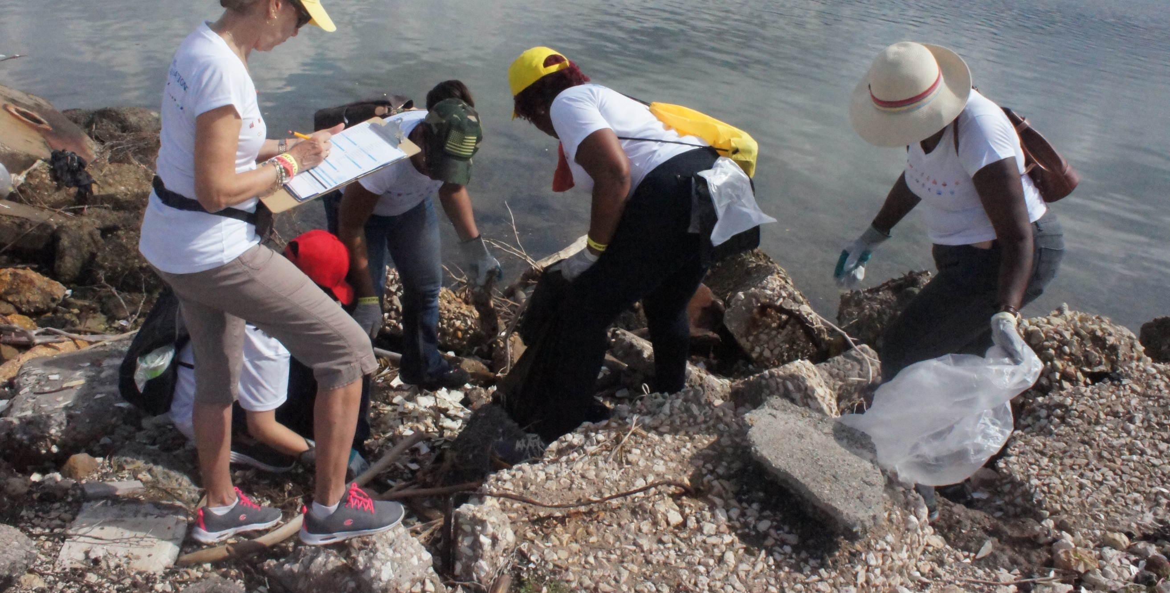
BEST PRACTICE
It’s about Lives & Livelihoods & Understanding root causes for Attitudes & Behavior!

Slide 25

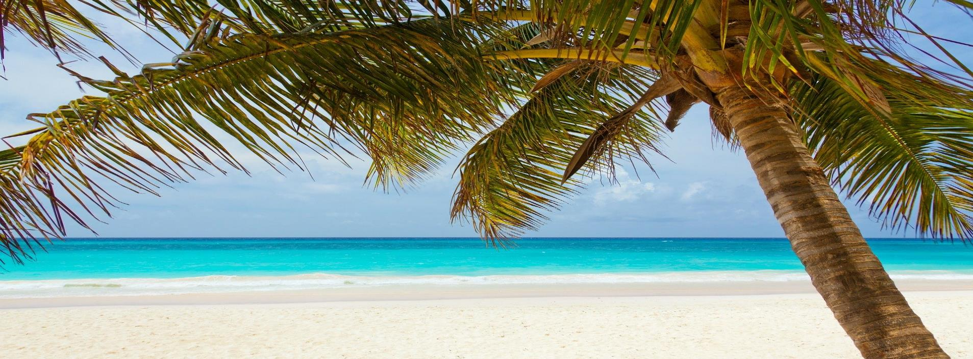





Protecting Our Caribbean Sea, Sustaining Our Future
THANK YOU/GRACIAS/MERCI
United Nations Environment Programme Caribbean Environment Programme
and Cartagena Convention Secretariat
14-20 Port Royal Street
Kingston, Jamaica, W.I.
https://www.unenvironment.org/cep/
unep-cartagenaconvention@un.org
UNEPCartagenaConvention
UNEP_CEP
Youtube: CEPUNEP
LinkedIn: UNEP-Caribbean Environment Programme

