Slide 1
Waste management in the Western Indian Ocean region: the case of Comoros
Mwangi Theuri Project officer Nairobi convention secretariat

Slide 2
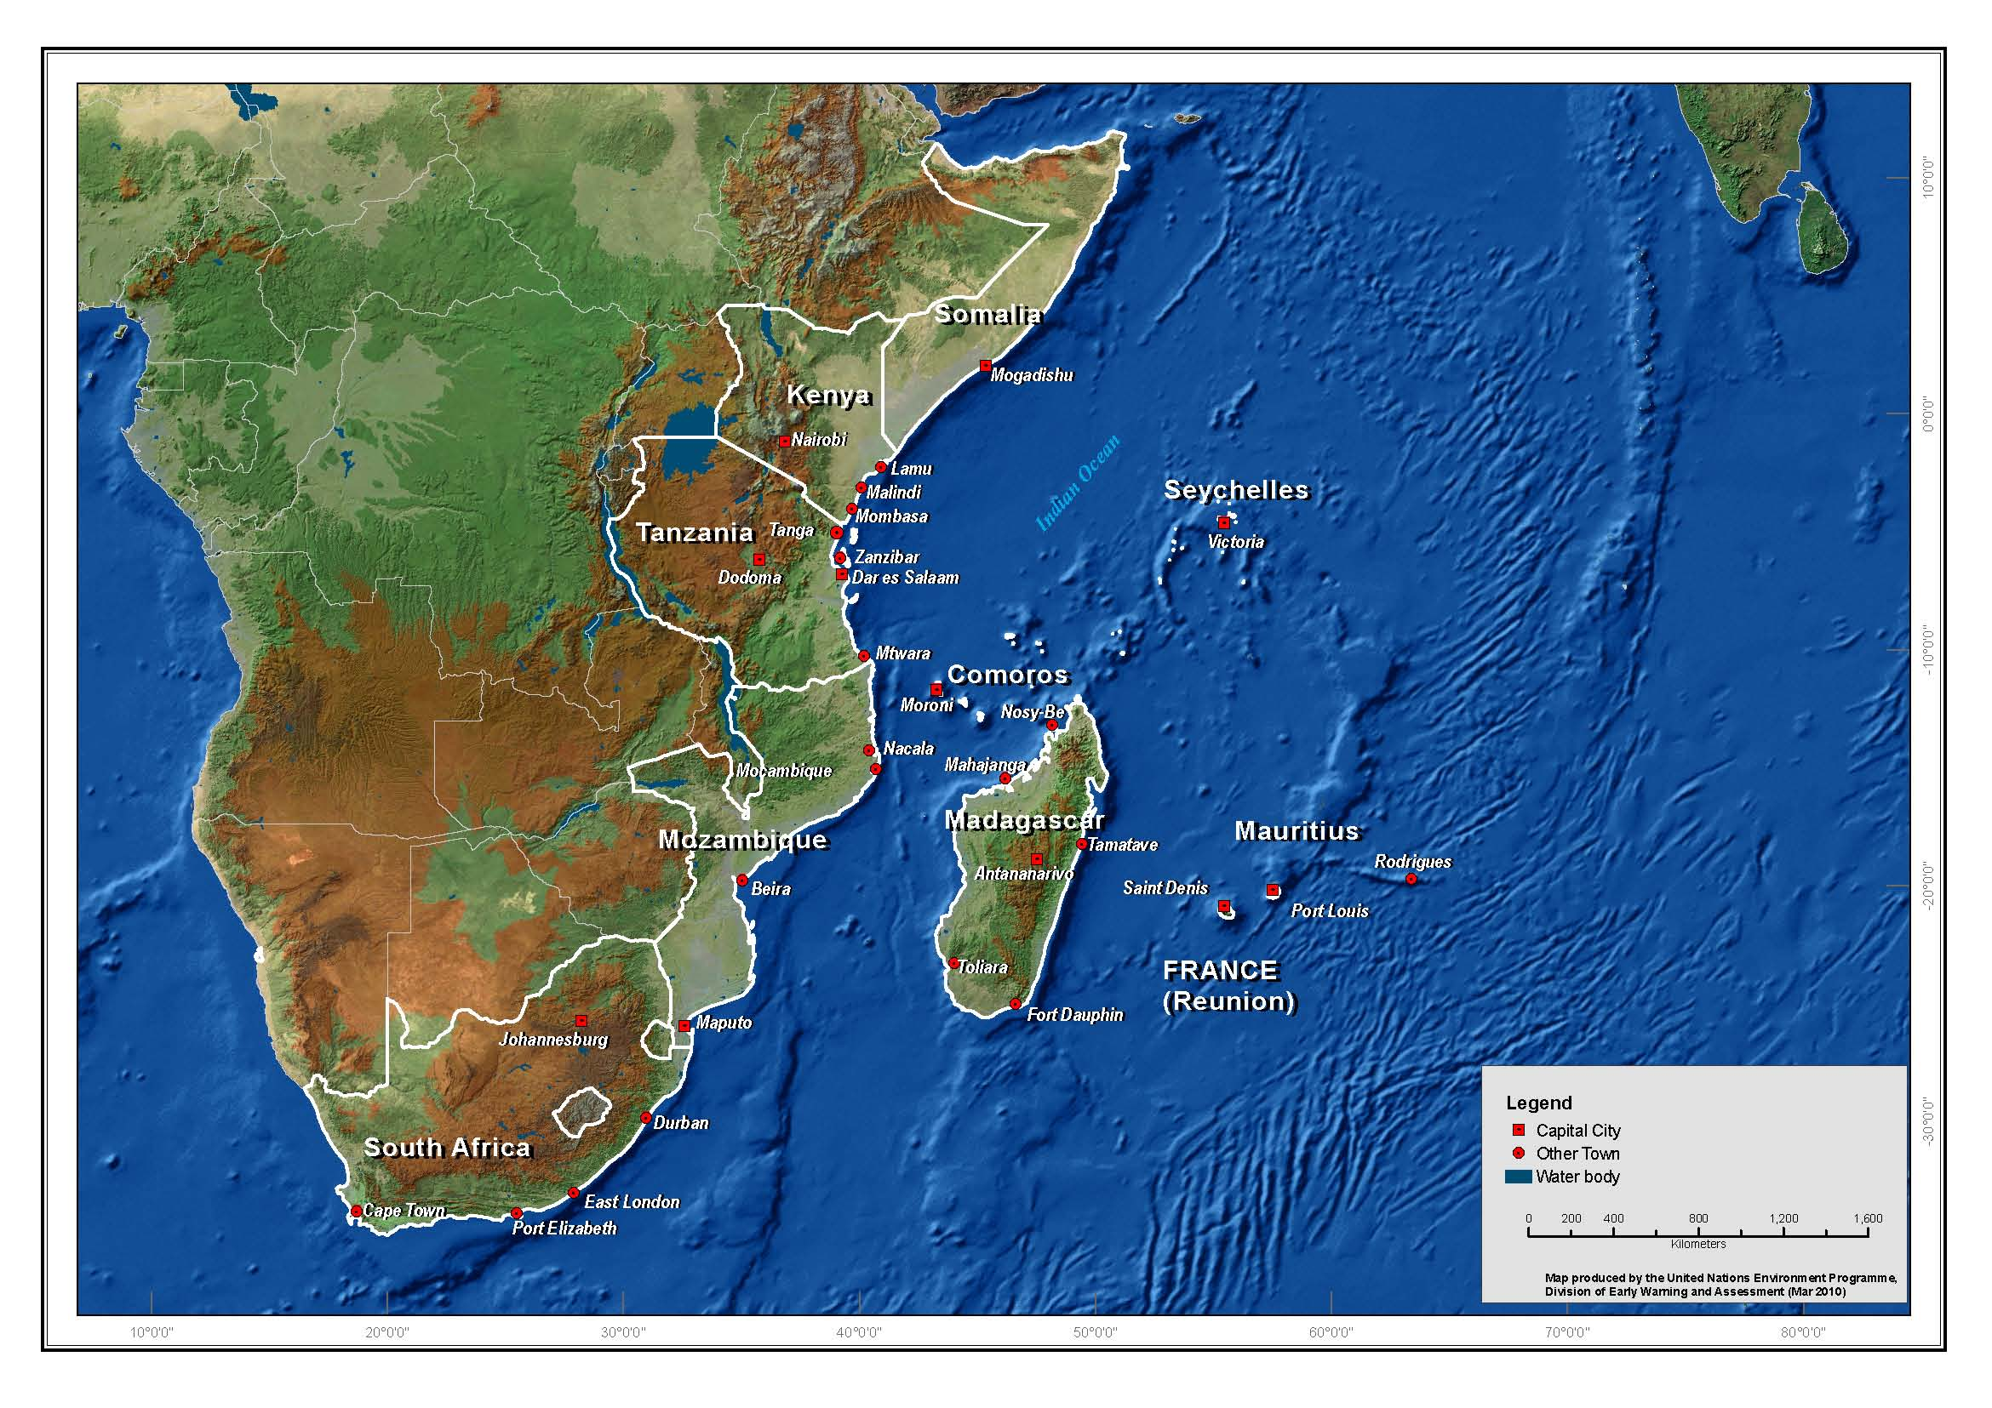
Outline
Addressing waste management in the Western Indian Ocean
Recognition of marine wastes at regional level
Best practices in waste management in the region
Challenges of waste management in Comoros
Role of women in waste management in Comoros
National Linkages
WESTERN INDIAN OCEAN

Slide 3
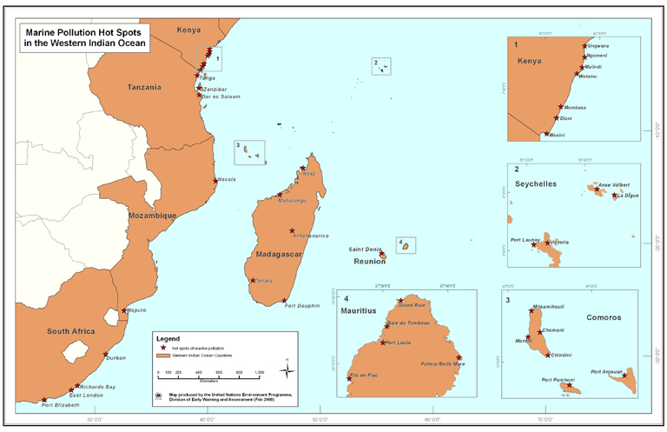
marine pollution hotspots in the western indian ocean
Around urban areas
river discharges from larger catchments into the sea

Slide 4
Recognition of marine wastes at regional level
Western Indian Ocean Strategic Action Programme (2010)
Increasing levels of municipal (domestic and industrial) effluents into the ocean are threatening human health and ecosystem integrity.
Develop regionally acceptable effluent and water quality standards for public health
Construct wastewater treatment systems for all municipal effluents before they are discharged into estuaries and the Ocean.
Develop municipal solid and waste management policy, strategy and action plans
Involve all stakeholders (households, NGO, CBO, private sector, municipality),
Marketing the region as a safe, clean destination to local and international tourists
Sustaining export markets for fish and other marine products harvested from clean, healthy Ocean.

Slide 5
Regional decisions on waste management
Decision CP.9/2 (2018) Decision CP.8/2 (2015), CP.7/2 (2012). Protocol on Land Based Sources and Activities affecting the marine environment
Decision CP.9/3 (2018) Management of marine litter and municipal wastewater in the Western Indian Ocean

Slide 6
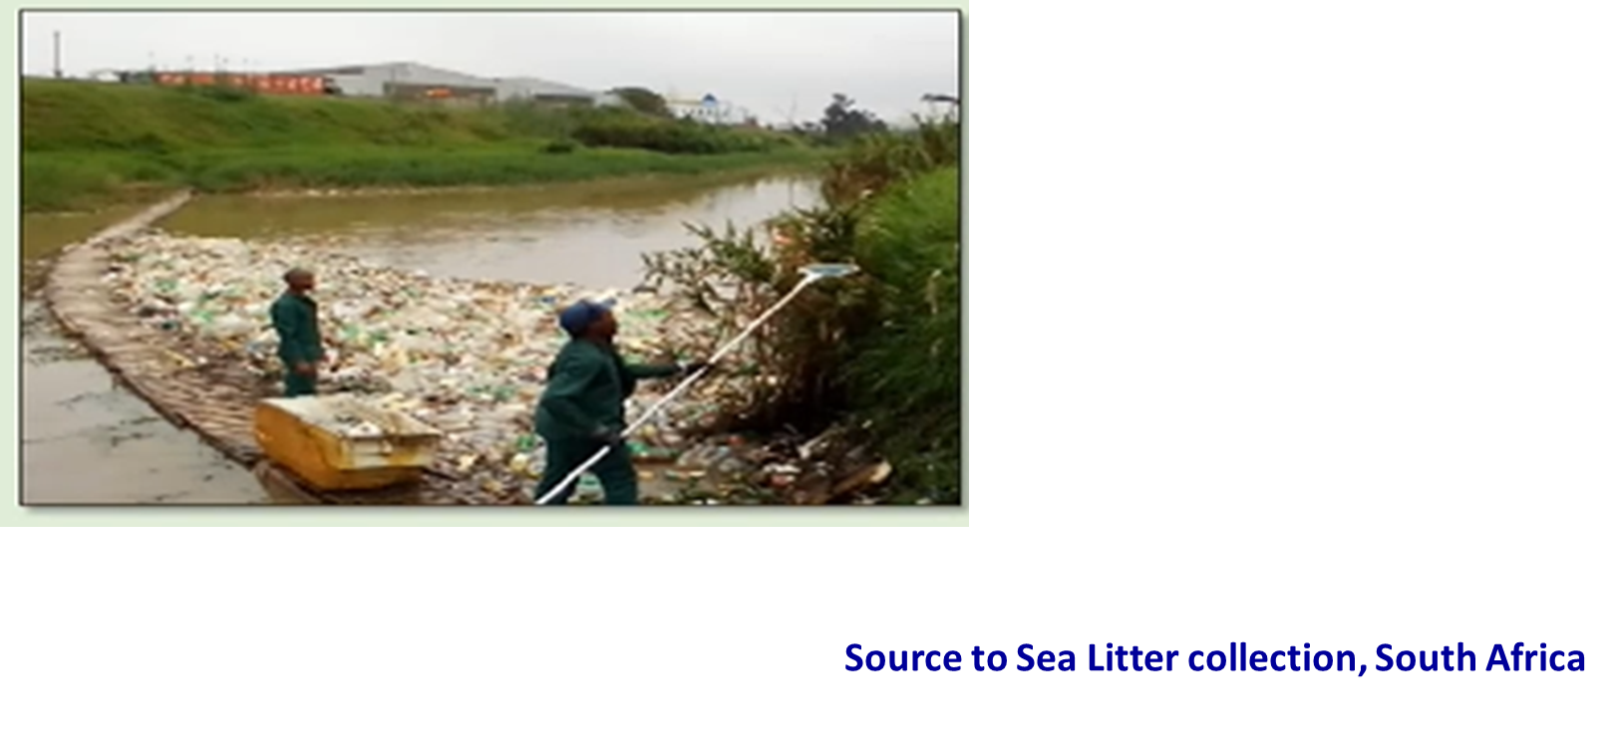
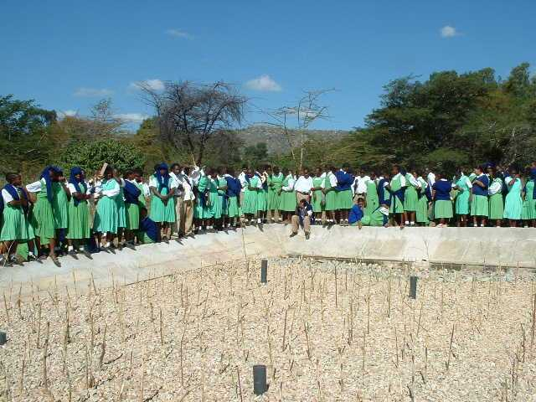
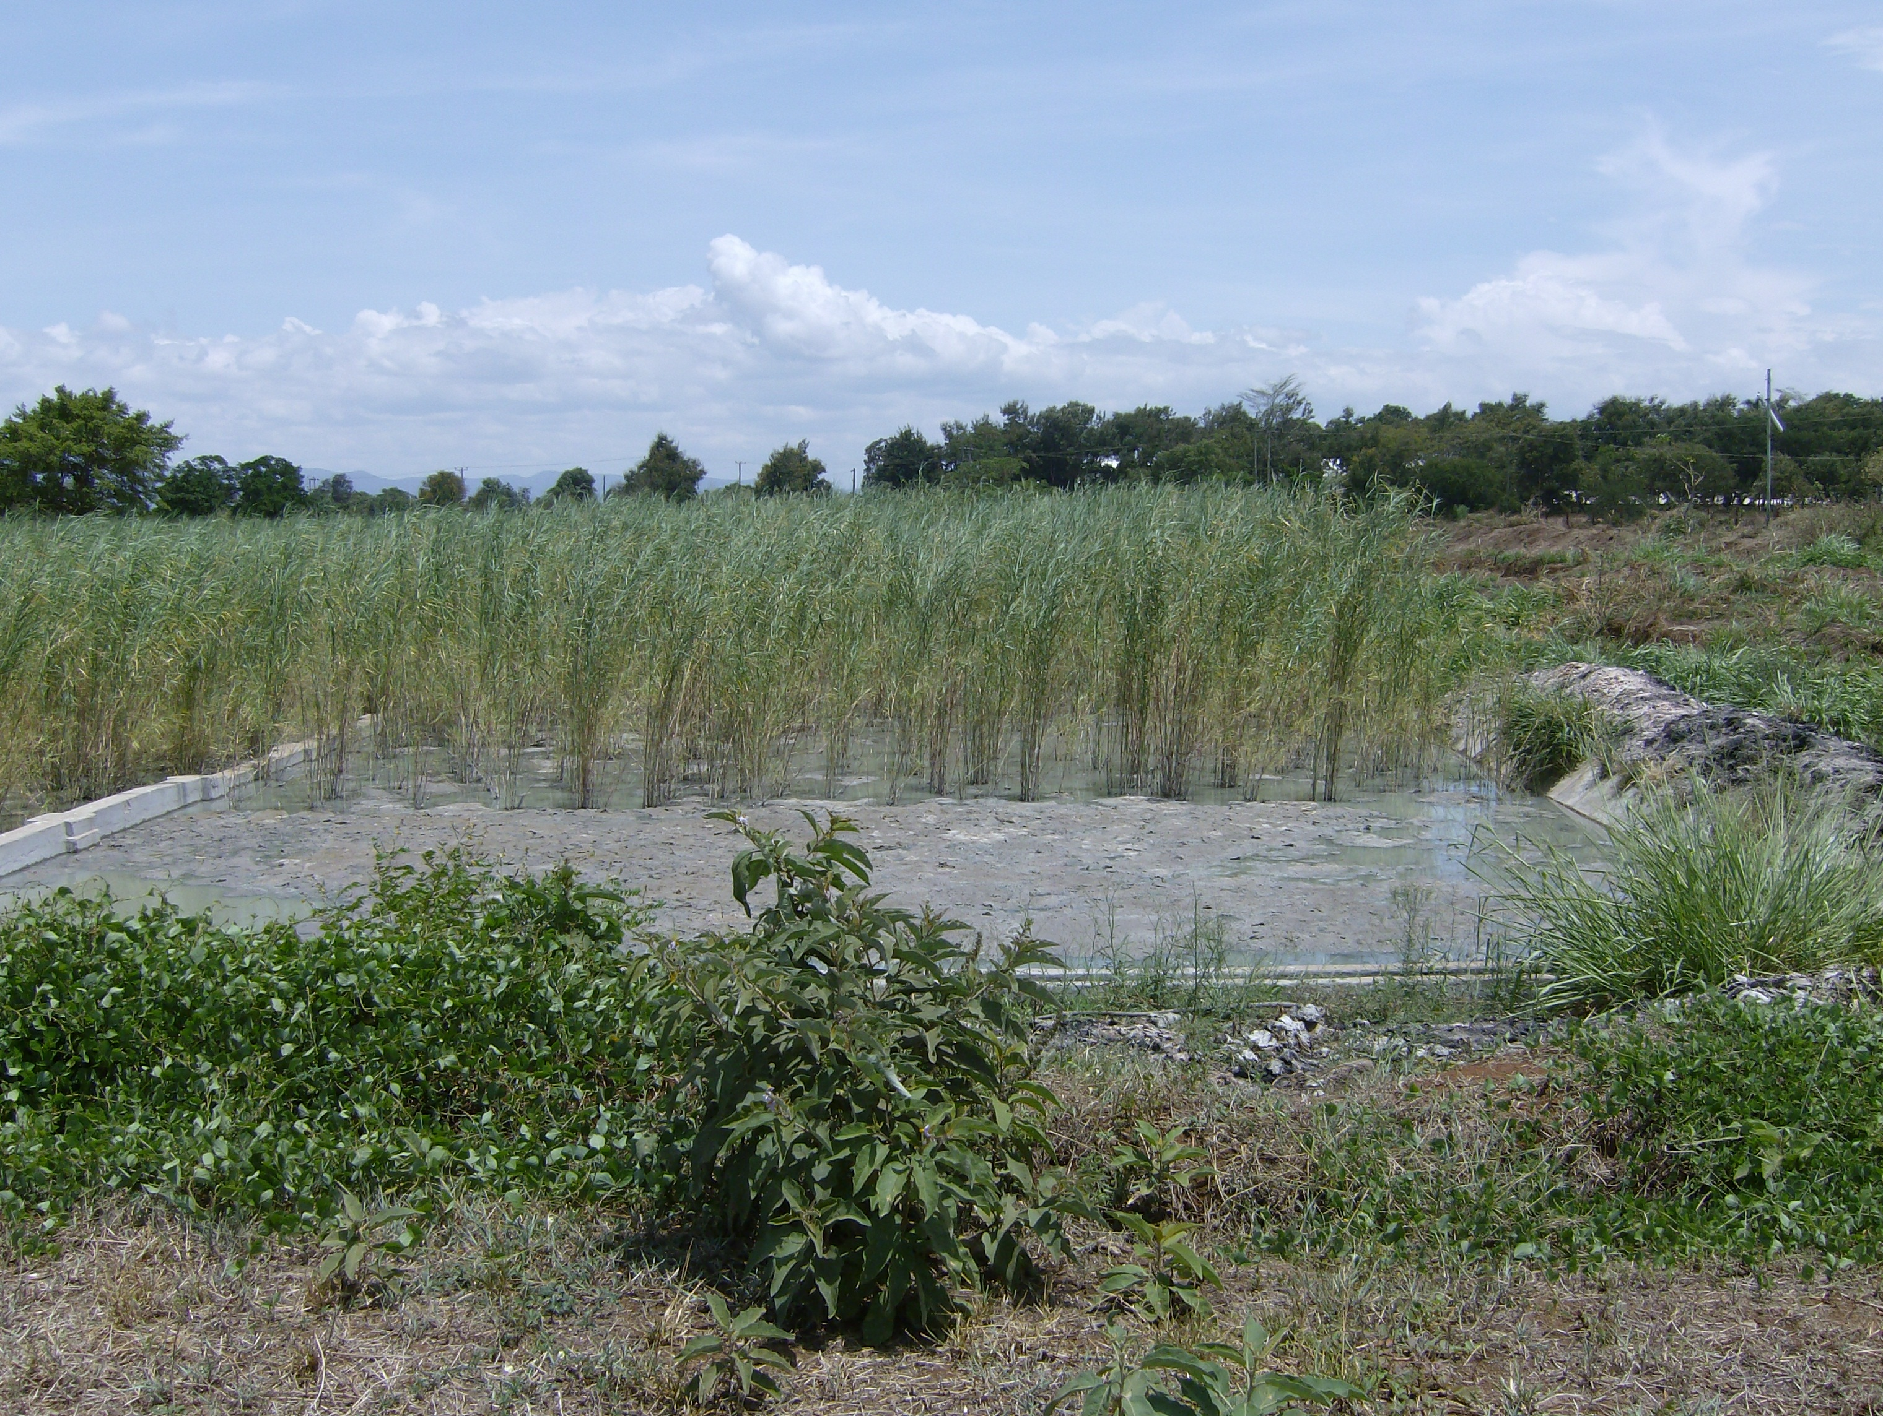
Action on Waste management ongoing
Photo credit: Benguela current
Source to Sea Litter collection, South Africa
Constructed wetland, Shimo la Tewa prison, Kenya
constructed wastewater treatment in a Farm, South of Mahé, Seychelles
Msingini Wastewater treatment facility, Chake Chake, Pemba
Estuarine Water quality Management, South Africa
Constructed wetland, Maswa, Tanzania
Photo credit: Benguela current

Slide 7
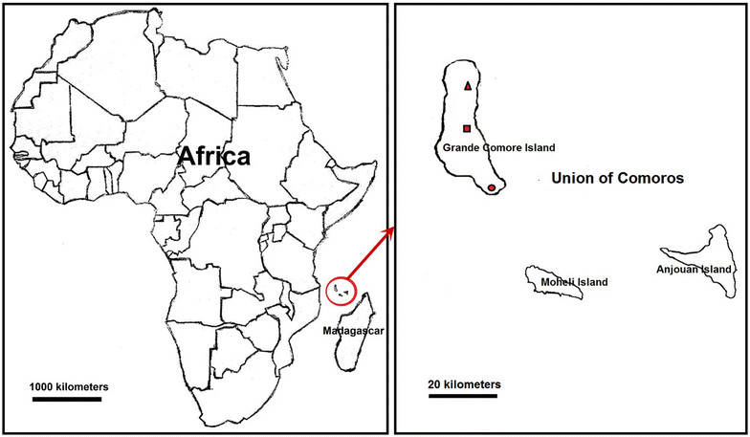
Marine litter action plan for Comoros
The Comoros covers a total area of 2,235 km², a coastline of 340 km
Estimated population in Comoros was 869,601 people at mid-year 2020 (UN data)
Majority of the population are concentrated at coastal areas
Waste management is a devastating environmental problem in Comoros

Slide 8
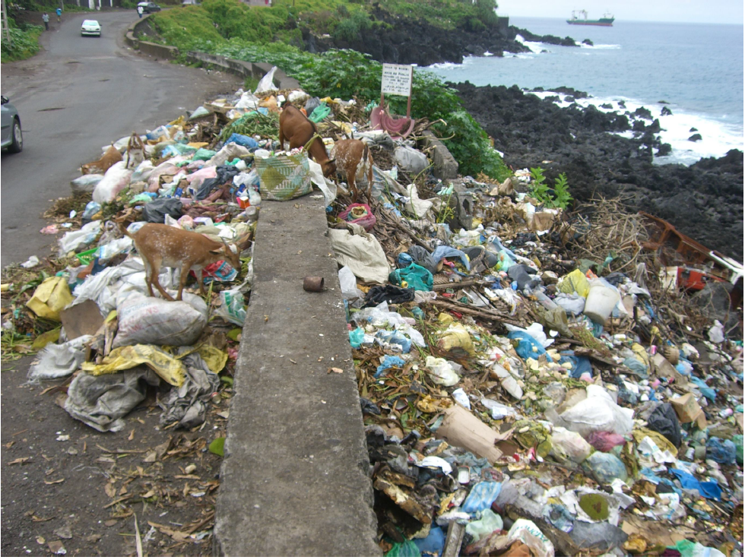
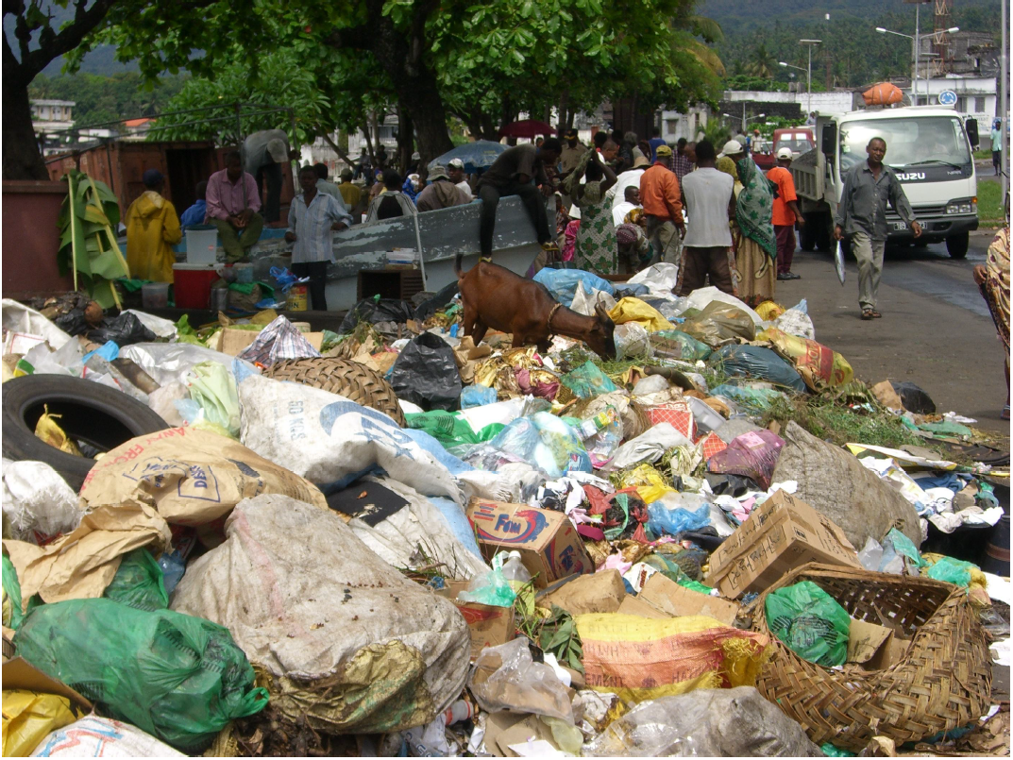
Challenges of waste management in Comoros
Lack of a policy on urbanization thus development has been spiralling up
Increased waste generation and proliferation of illegal dumping sites
Integrated waste management systems are non-existent (for collection, treatment, safe disposal, recycling, composting)
Lack of technical and infrastructure capacities to manage waste
Limited regulatory frameworks to monitor and manage waste
Limited knowledge by the communities on impact of waste pollution on marine environment

Slide 9
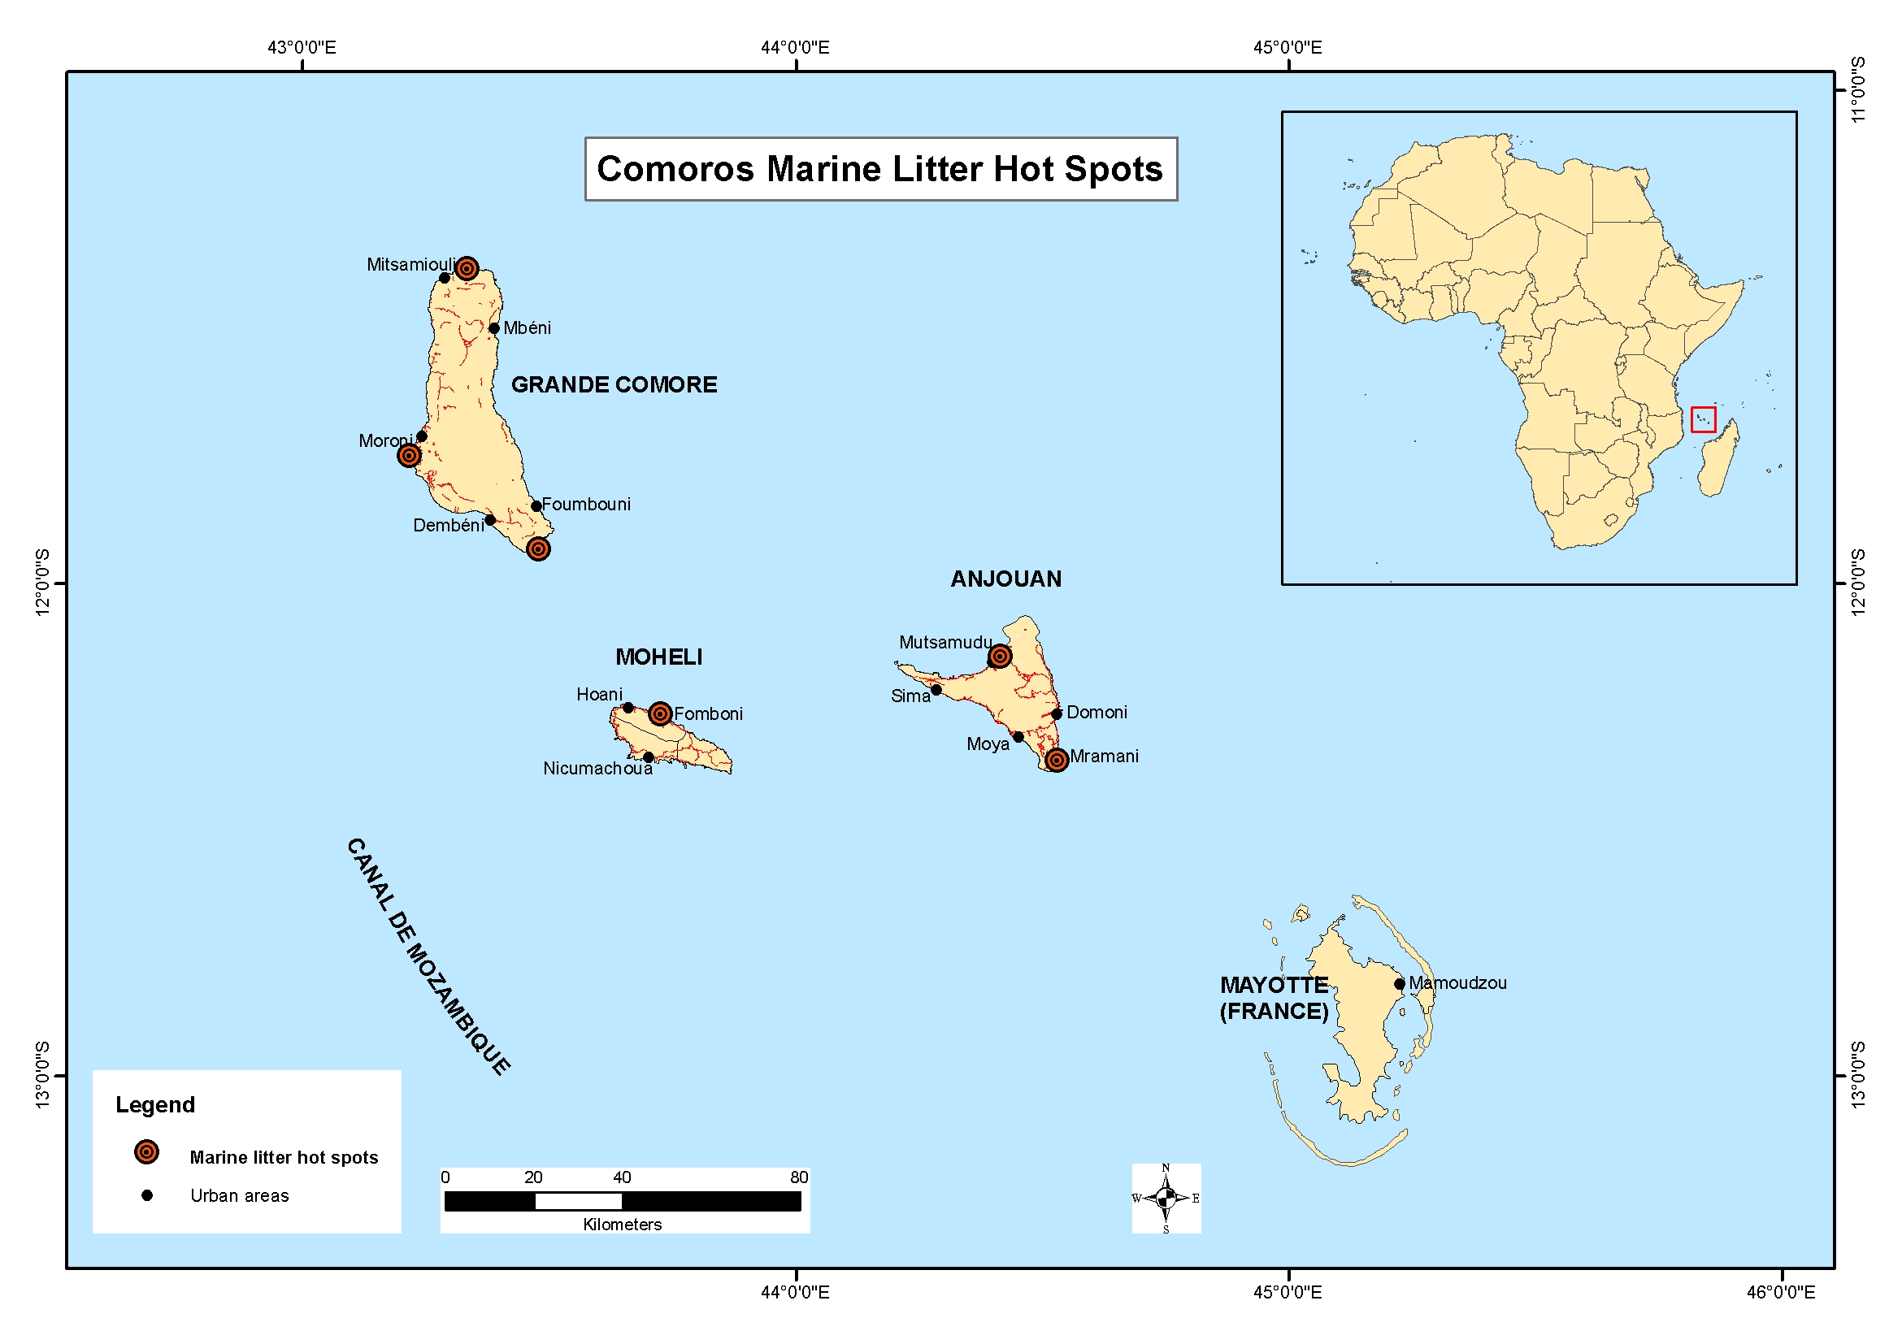
Comoros Marine Litter Hotspots
The marine litter, wastes and plastics mainly come from:
Households
Hospitals
Industries
Hotels
Litter and sediments in rivers

Slide 10
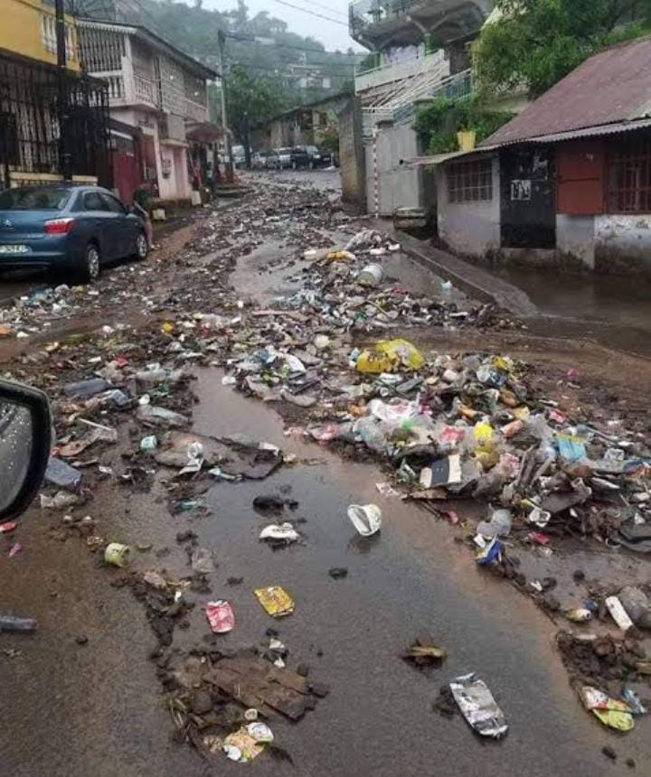
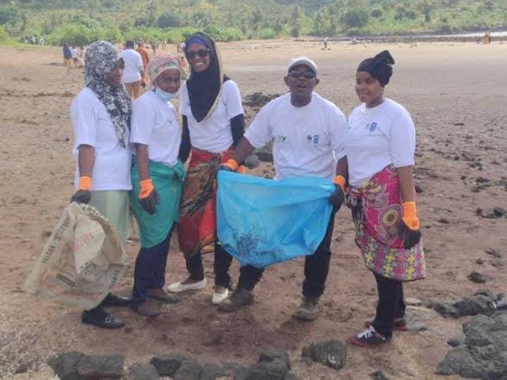
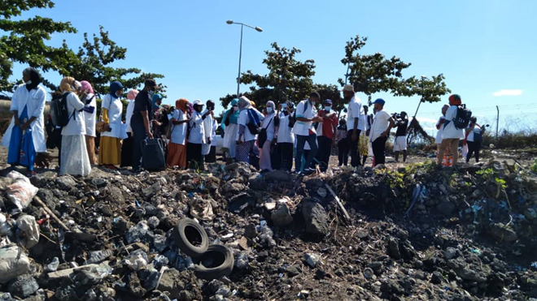
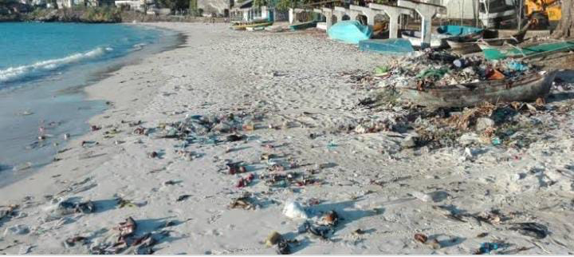
Women in Action Making Comoros clean
Clean Seas Campaign in Comoros

Slide 11
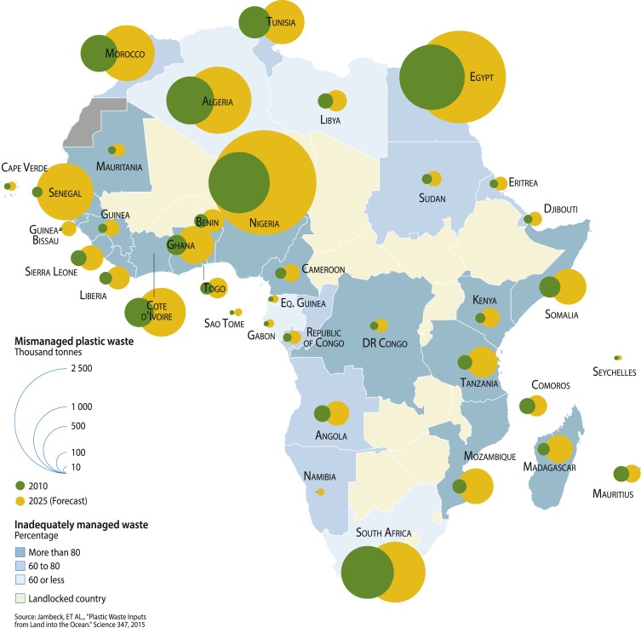
Developing Marine litter action plan for Comoros
Comoros is developing a national marine litter management strategy and action plan informed by the regional action plan on marine litter:
To inform on the status of marine litter in Comoros
All stakeholders are involved: women, youth, communities, NGO, CBO, private sector
Awareness campaigns on impacts of wastes in the ocean
Challenges and emerging solutions to the land-based plastic waste

Slide 12
Linkages with national frameworks on Waste management
The marine litter action plan will support
development of Comoros waste management policy
Establishment of a proposed national waste management agency
Enforcement of the ban use of non-biodegradable plastic bags.

Slide 13
Thank you!

