Slide 1
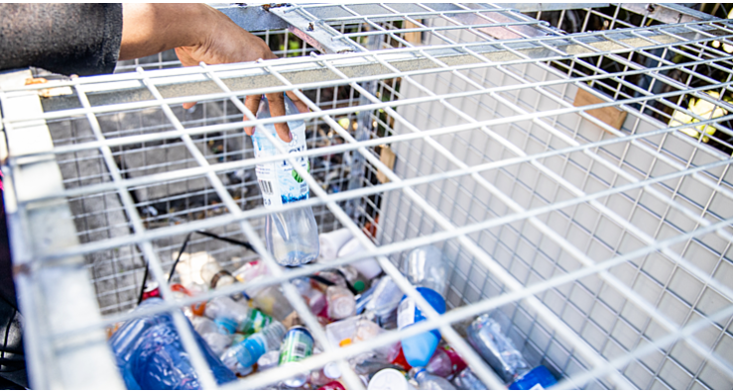
Women & Waste Management in Samoa

Slide 2
Outline
Objective: Samoa to have an in country solution to repurpose plastic waste & other waste streams
Plastic Waste Dilemma in Samoa
Issues in Waste Management in Samoa
Role of Women in Waste Management in Samoa

Slide 3
Plastic Waste Dilemma in Samoa
Plastic in the form of plastic shopping bags have been successively banned in Samoa (The Waste Plastic Management Regulation 2018)
Banning of plastics is not the answer to solving the issue - its going to be at the consumers expense
Substitute will be more expensive
No social welfare
Samoa is remotely isolated
Samoans use 34.5 kg of plastic per person annually
population average of 200,000 = over 7,000 tonnes yearly

Slide 4
Plastic Waste Dilemma in Samoa
Since starting my business in 2008, as a company that initially supplied purified bottled refills,
Accumulated waste of damaged plastic bottles
Disposal in landfills only generated more environmental & social issues.
Business operations expanded over the years into mass production of bottled water, plastic waste management became my biggest challenge

Slide 5
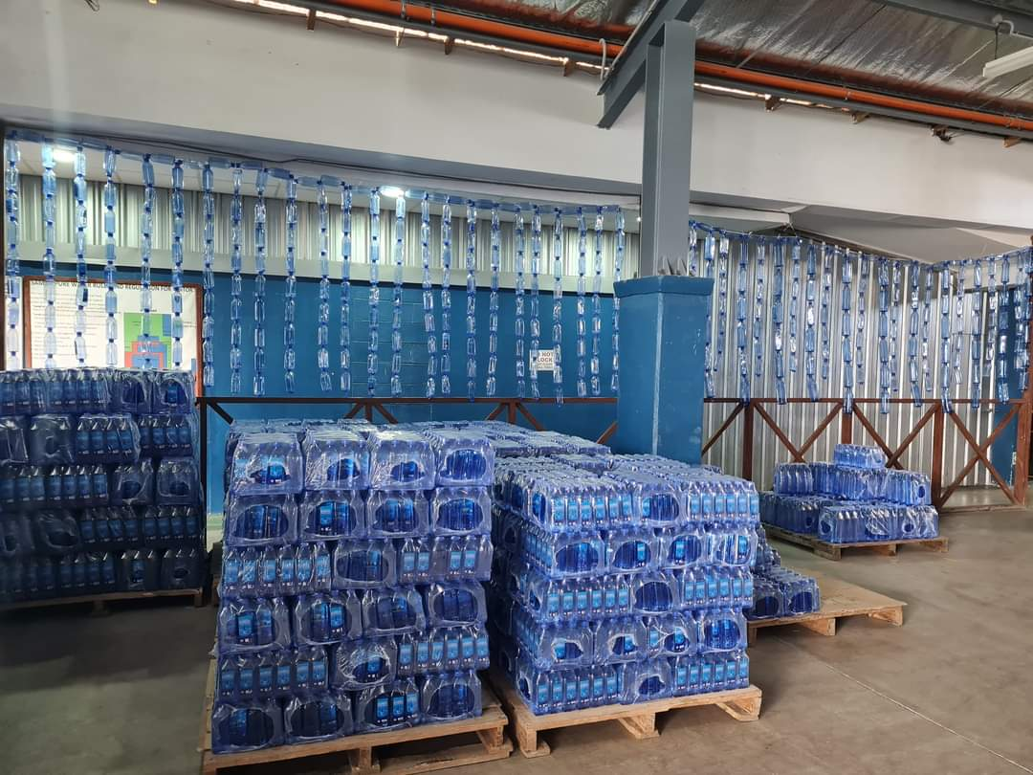
Figures of Imported Preforms a year for Samoa Pure Water
Imported PET preforms annually is 35,000 tonnes
This is for Samoa Pure Water alone, there are more than 20 businesses that use PET preforms for their beverages, juice or water products
This does not include other plastic material for packaging & promotion

Slide 6
Issues with Waste Management in Samoa – ‘Plastic’
Lack of segregation of different forms of plastic in Samoa – regulations are not enforced nor monitored properly
Lack of accurate studies/ data availability on different types of plastic entering Samoa
Lack of funding to support initiatives in waste management
Time is neglected (investing of time in practical solutions & less discussion)
Lack of collaborative effort because its not a money making machine
Perception of plastic as rubbish or discarded after its use

Slide 7
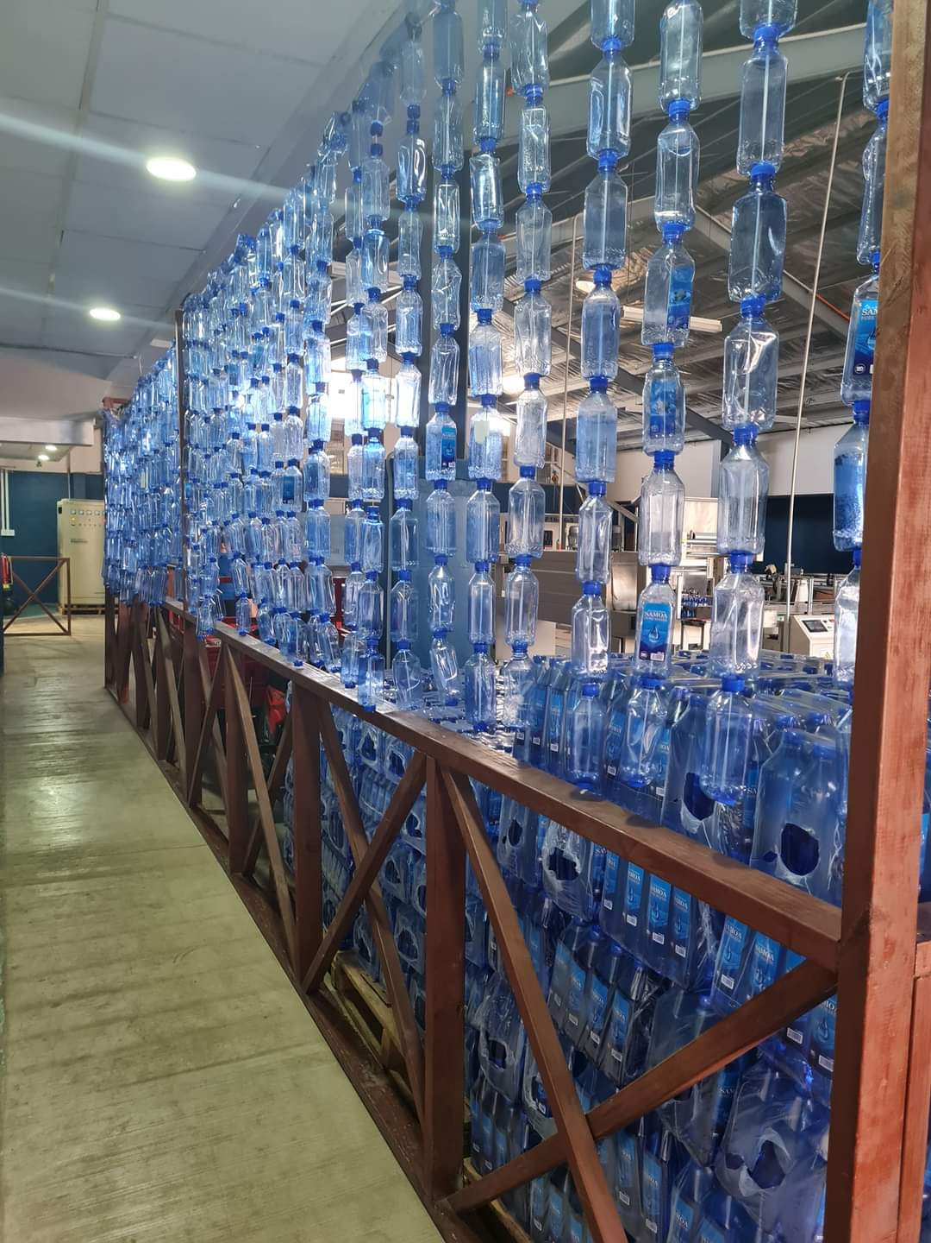
Issues with Waste Management in Samoa – ‘Plastic’
Solution – sustainable & holistic approach to management of plastic waste in Samoa by repurposing or modifying it into other products with long shelf life
Collaborative approach between private sectors and public sectors
Capitalise on networking relationship between businesses and government
Regional discussion/solution involving all stakeholders especially waste generators
My journey has connected me with brilliant individuals with ideas & technology that can use all forms of plastic waste to convert to useful items such as – e-block for building
Tupperware, clothing & other household utensils

Slide 8
Role of Women in Waste Management in Samoa
Samoan women have been leading the way in waste management in Samoa, with several female advocates forming organisations to tackle the issue as a whole.
As a mother we are the ‘pae ma ‘auli o aiga’ meaning we are the protectors of our family especially our children; hence this saying is what I base my business & moral principles, I strive to ensure that my children and future generations live in clean and safer environment
This dream I share with our partners in the Samoan business community saw the creation of STAR – Samoa Tokelau Association of Recyclers – for business to unite to find a solution to repurpose all waste streams generated in Samoa in a sustainable manner.

Slide 9
To achieve Sustainable Approach Waste Management in Samoa
Require the right partners that are as driven as us to take immediate action of repurposing plastic & other waste streams in a sustainable way
Immediate access to funding, technology & resources
Require collaborative effort of all stakeholders & interested parties, the fight is ours and the win is for our future
Timing is of the essence
We only have one precious planet its in our best interest to protect it. I take pride as mother knowing that they are well aware of my stand to fight for their futures as well as their children’s future

Slide 10
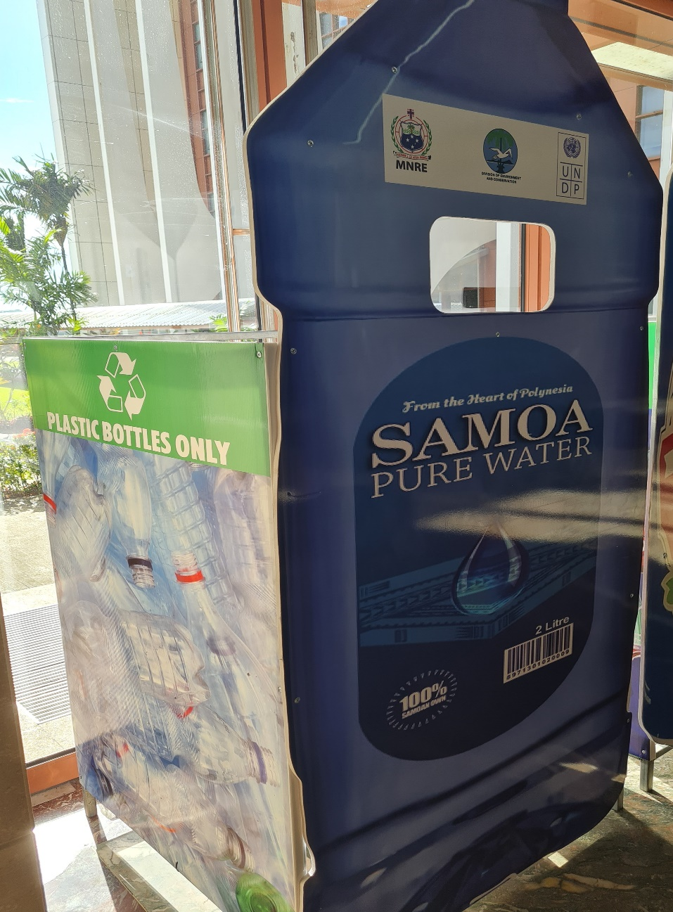
Thank you

