Slide 1


ABS Initiative Pacific Update:
RSC/INFP4.1/02/2022
2020/21 – 2022 ABS Activities
February 2022 Pacific Steering Committee
Prepared by Professor Daniel Robinson

Slide 2
2020/21 Main Activities:
ABS Workshops: 2xPNG, 1x Sol Is, 1xTonga, 1x Tuvalu, 3 x regional webinar (Sept 20, Dec 20, July 21).
ABS in-country consultants: PNG since September (ABS Policy and ratification), Vanuatu has new consultant Dec 2021 (ABS law amendments and alignment with TK Act).
Pacific patent landscaping and biotrade report.
Support for ABS contracts through workshops, assistance with model MAT, and MAT templates.
Support for development of ABS regulations (Palau, Vanuatu) and policy (PNG).
Proposed 2022 activities

Slide 3
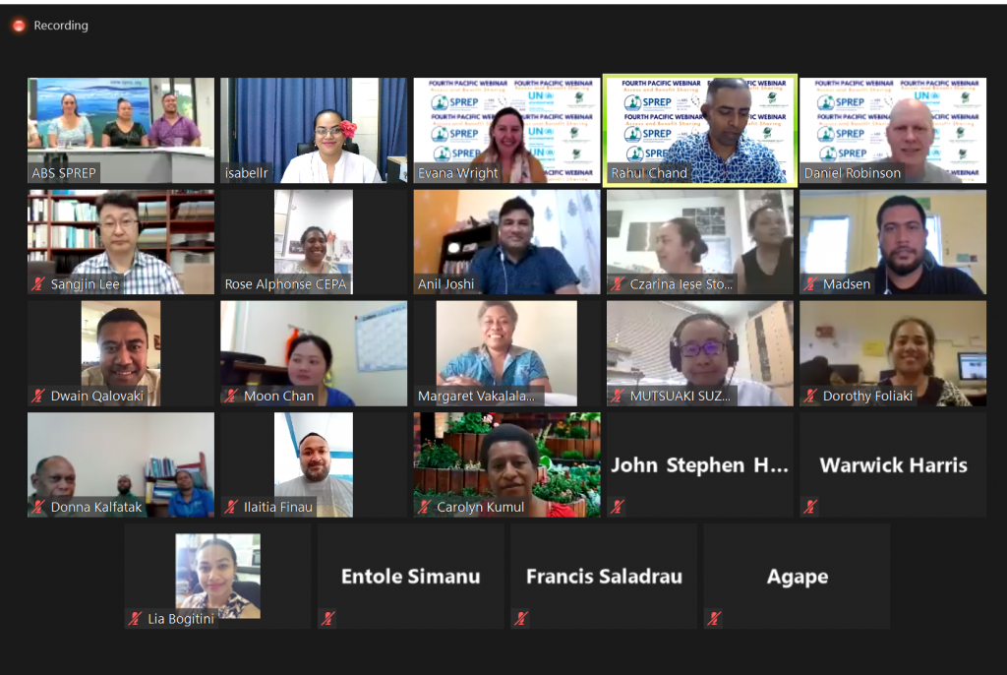
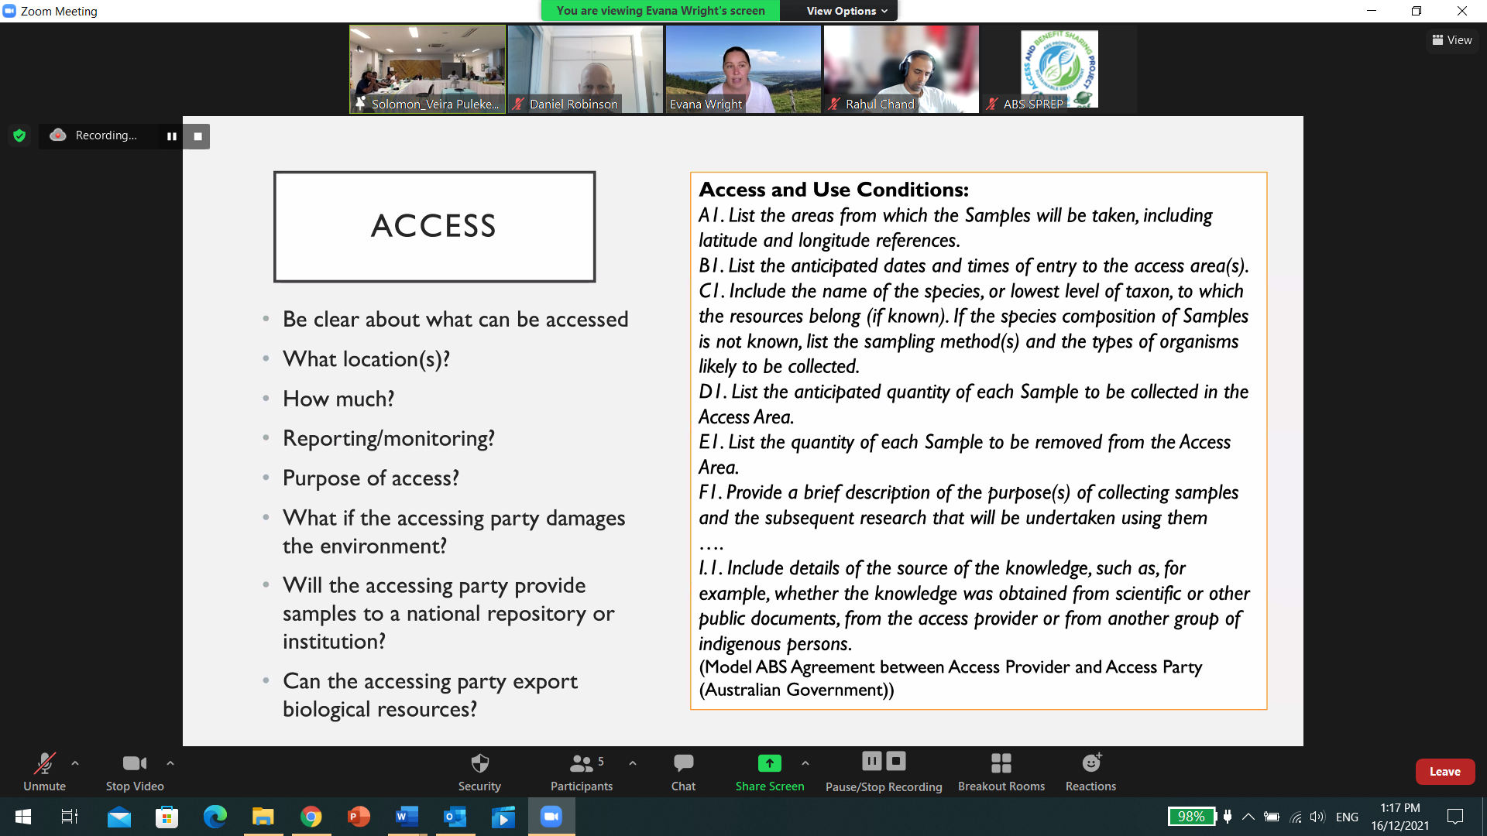
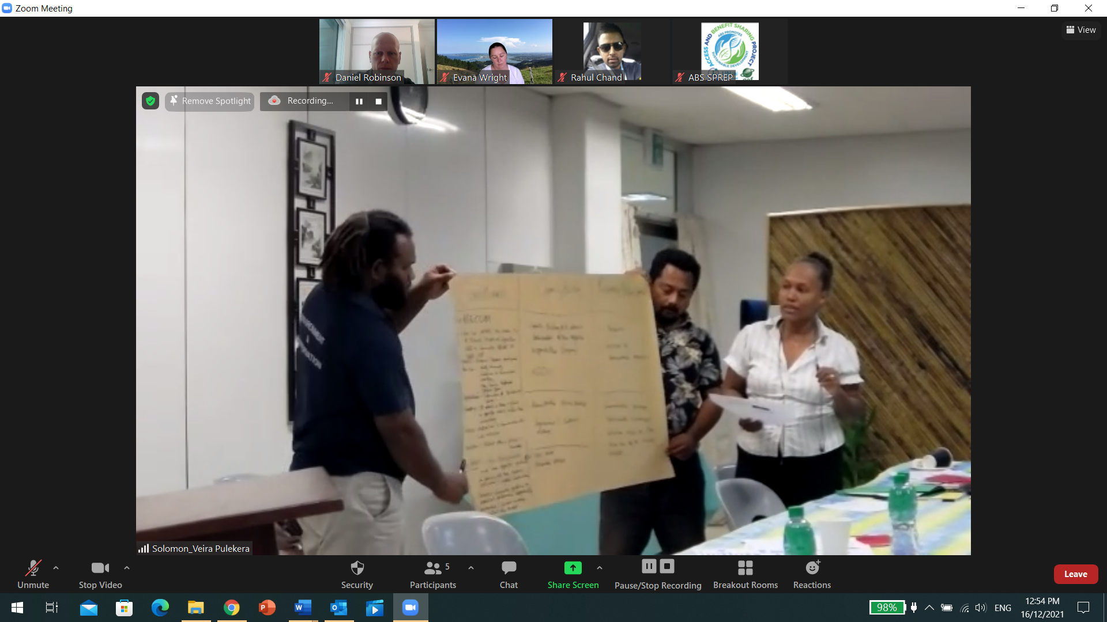
2020/21 Workshops:
ABS Workshops with SPREP: 2xPNG, 1x Solomon Is, 1xTonga, 1x Tuvalu, 3 x regional webinar (Sept 20, Dec 20, July 21).
Aims: support ratifications (PNG) and support implementation and processes among recent ratifications (Tonga, Solomon Is.) and to enhance existing ABS systems (Tuvalu). Also technical advice, awareness raising, examples, MAT contracts etc.

Slide 4

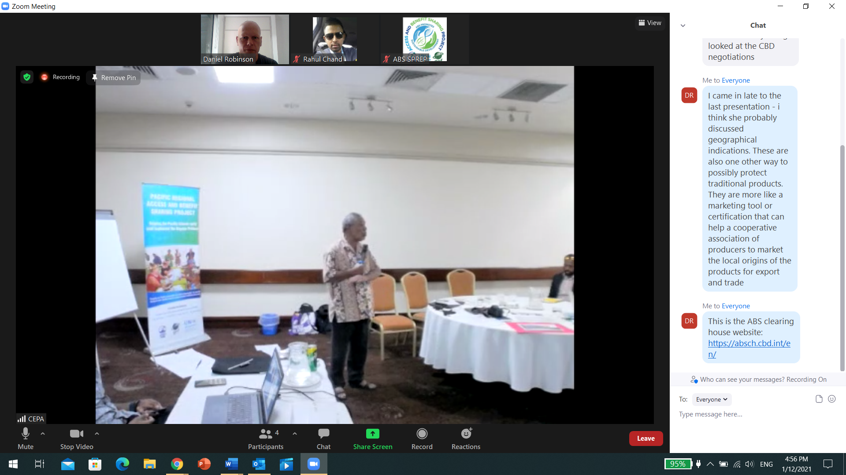

2021/22 ABS Consultants:
ABS in-country consultants: PNG since September (ABS Policy and ratification), Vanuatu has new consultant Dec 2021 (ABS law amendments and alignment with TK Act).

Slide 5
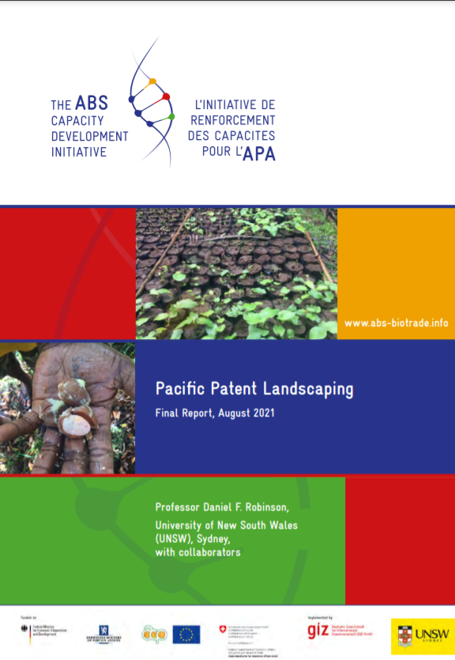
2021 Patent Landscape and Biotrade:
Pacific patent landscape report highlight patents on many species (e.g. 200 patents on uses of kava).
The report also examines implications for ABS in the biotrade context (e.g. trade in Calophyllum inophyllum or ‘tamanu’/dilo nut).
Biotrade value chain fieldwork was undertaken in 2018-2019 but has been on hold since due to COVID-19. Now - desktop analysis.

Slide 6
2020/21 Technical support:
Support for ABS contracts through workshops, assistance with model MAT, and MAT templates.
Work on a MAT template for Vanuatu with Dr Fran Humphries and the local ABS consultant
Support for development of ABS regulations (Palau, Vanuatu) and policy (PNG).

Slide 7
Engagement with IPLCs:
Biocultural protocol development began in Vanuatu and Cook Islands in 2018-2019 (ARC DP).
Community awareness raising with posters and Bislama video undertaken in 2018-19, particularly in Vanuatu and Cook Islands. Some engagement with NGOs in Solomon Islands, Fiji.
Interrupted since 2019 by COVID-19.

Slide 8
Possible 2022 Activities:
Possible participation in High level TK Webinar.
Participate in ABS workshop with FSM?
Participate in ABS workshops on contracts and clearing house with Samoa?
Participate in W/Shops with Nauru and Niue? Kiribati?
Possible Vanuatu workshop at end of ABS consultancy.
Comms materials including ‘ABS: Lessons from the Pacific’ summary report.
Ongoing support for PNG and Vanuatu ABS consultants.

